Slide 1
Striving for semantic harmony across datasets, communities, and real-world data
Chris Stoeckert, Ph.D.
Department of Genetics, Institute for Biomedical Informatics
Perelman School of Medicine, University of Pennsylvania
ICBO 2022
Michigan League, University of Michigan, Ann Arbor, MI, USA
CCBOT-2022
Notes:
Thank you Oliver and all the co-organizers of this ICBO meeting. Also thank you to Prof. Xiaolin Yang for including this talk in the upcoming Chinese Conference on Biomedical Ontology and Terminology.
I’m honored and humbled to have this opportunity to share my perspective on biomedical ontologies reflecting a decades long struggle to understand, develop, and apply them properly.
My talk is about striving for semantic harmony because for the projects I’ll describe we haven’t quite achieved it yet but we have made significant progress.

Slide 2
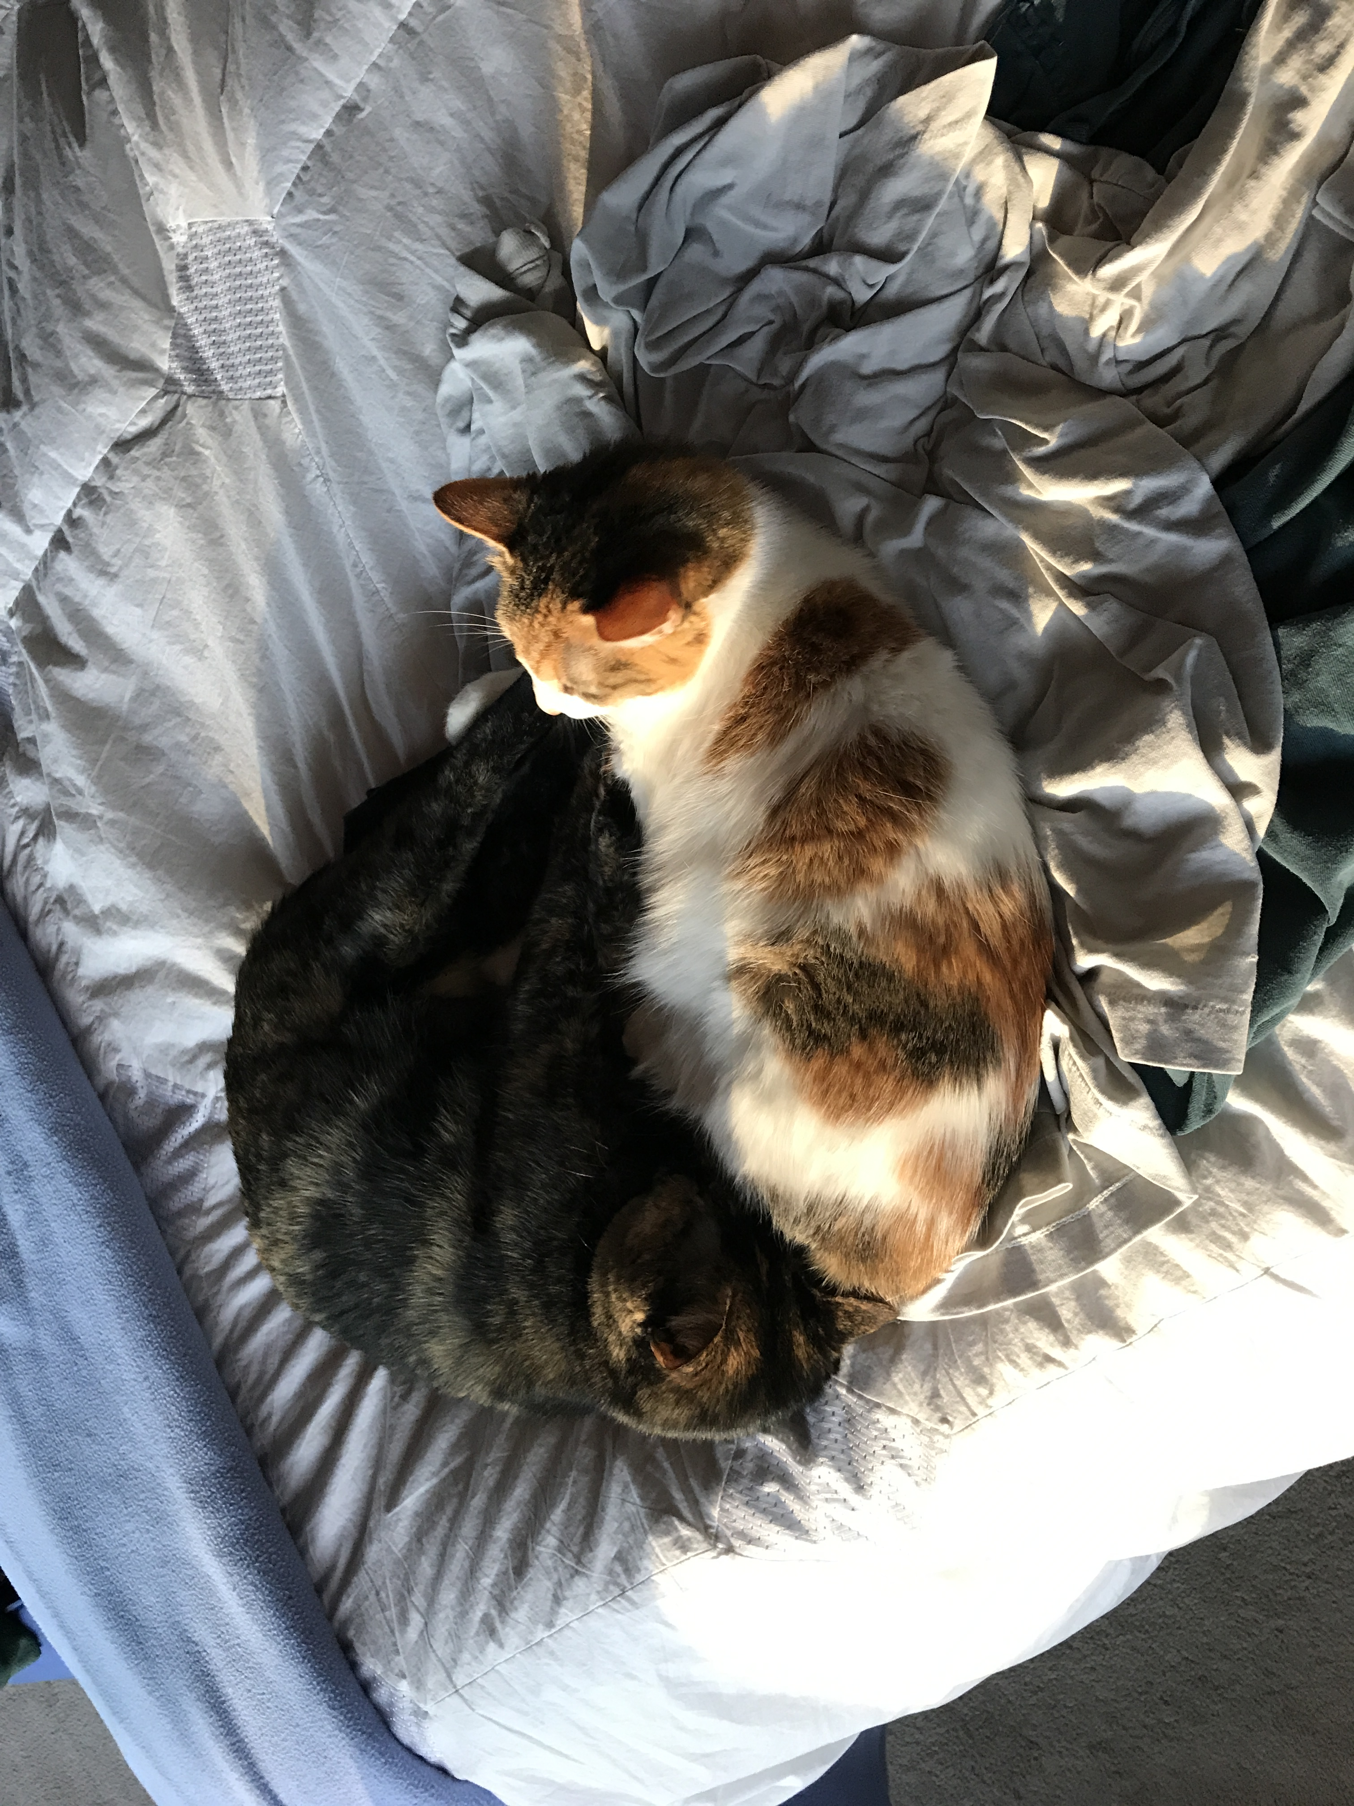
Semantic harmony
Consistent representation of data and what the data is about using ontology terms.
Consistent development, management and application of ontologies.
Balance of “we need it now” pragmatism and “do it correctly” formalism.
Cocoa and Emma as yin-yang
Notes:
By semantic harmony I mean consistent representation of data ... ontology terms as well as consistent development …. My work in this area started over 20 years ago, with integration of genomics datasets for analysis and then harmonization of data for management in a common data model. That led to applying terminologies particularly in the form of ontologies and then becoming involved in building ontologies to represent not only what the data is about but how it was generated. Working in this area has made me realize the need for semantic harmony as the balance of having something now for projects versus taking the time to do things in a formally correct way.

Slide 3
Ontologies* can support different aspects / multiple dimensions of standardization at the same time
Ontology
Instances in triples (ABox)
classes with relations (TBox)
defined terms with IRIs
Not everyone needs to work in all dimensions but a better understanding of each will make for better usage.
* See Rector et al.: On beyond Gruber: “Ontologies” in today’s biomedical information systems and the limits of OWL. J Biomed Inform. 2019;100S:100002.
Notes:
Ontologies as I’ll be describing them are well-defined terminologies, with logical relationships, and designed for both humans and computers to use. Alan Rector and Colleagues have a very nice recent paper discussing what it means to be an ontology in today's biomedical information systems so I’ll refer you to it for details on that. Instead I’m going to highlight three aspects or dimensions of biomedical ontologies namely as terms for annotations or tagging, terms for defining classes of things, and terms applied to instances of things.
I hope to convince you that “Not everyone needs to work in all dimensions but a better understanding of each will make for better usage.”
I’ll be referring to these aspects of ontologies as IRIs, TBoxes, and ABoxes so will start by defining them.

Slide 4
Definitions to get us on the same page
Internationalized Resource Identifier (IRI). A Universal Resource Identifier or URI with an expanded character set.
Identifiers for finding things on the internet.
e.g. http://purl.obolibrary.org/obo/OBI_0000070 or OBO: OBI_0000070
Ontology terms are more than just the label (like “assay”)
TBox (terminology): Expressions that contain universal statements about classes *
ABox (assertion): Expressions that contain assertions about instances *
Ontology
ABox
TBox
IRIs
* L. Vogt Journal Biomedical Semantics 2021 12:20
Notes:
IRIs are basically identifiers for things on the internet that can be used for ontology terms. As such they denote the entirety of ontology term, not just what the term is called or its label as these can be misunderstood especially if attention is not paid to term definitions.
Tboxes are about ontology terms that are classes and are typically the focus of building ontologies while ABoxes are about instances of those classes.
There’s an excellent paper on the application of Aboxes and Tboxes to phenotypes by Lars Vogt that begins with a really nice introduction that I recommend.

Slide 5
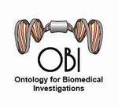
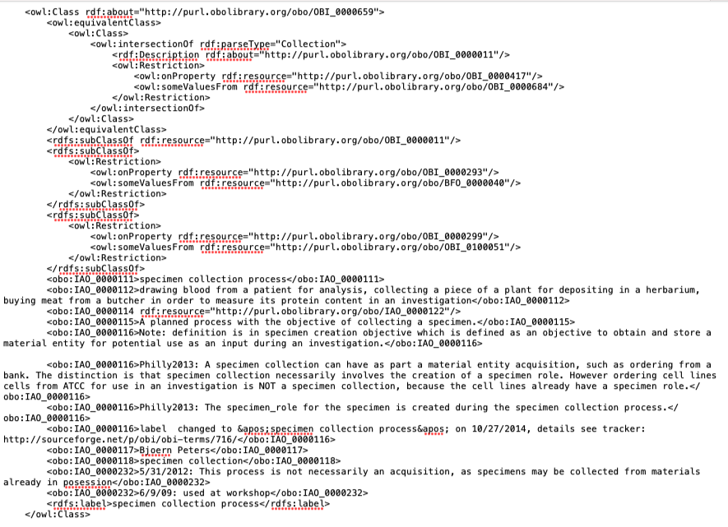
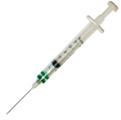
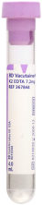
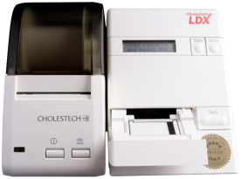

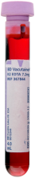
Referring to reality: IRIs and classes (TBox) and instances (ABox)
Process: specimen collection
Glucometer
Process: Assay
Measurement Datum
1.2 mg/ml
has specified input
has specified input
has specified output
has specified input
OBO:OBI_0000659
has specified input
has specified output
located in
OBO:OBI_0000070
Glucose molecules
Blood Specimen
part of
Bandrowski et al. The Ontology for Biomedical Investigations. PLoS One 2016
Notes:
Here are two examples from the Ontology for Biomedical Investigations (OBI) showing the IRIs with the OBO prefix. OBO refers to the Open Biological and Biomedical Ontology Foundry that I expect most are familiar with and I’ll be discussing in more detail later.
Specimen collection and assay are more than just the words or label, they are also the defined inputs and outputs that are applied to instances for example of this particular instance of a person and this particular blood specimen. The OBI class “specimen collection” is shown here in the web ontology language (OWL) to again to emphasize that the IRI is associated with all of these formal assertions not just what specimen collection might mean to each us.

Slide 6

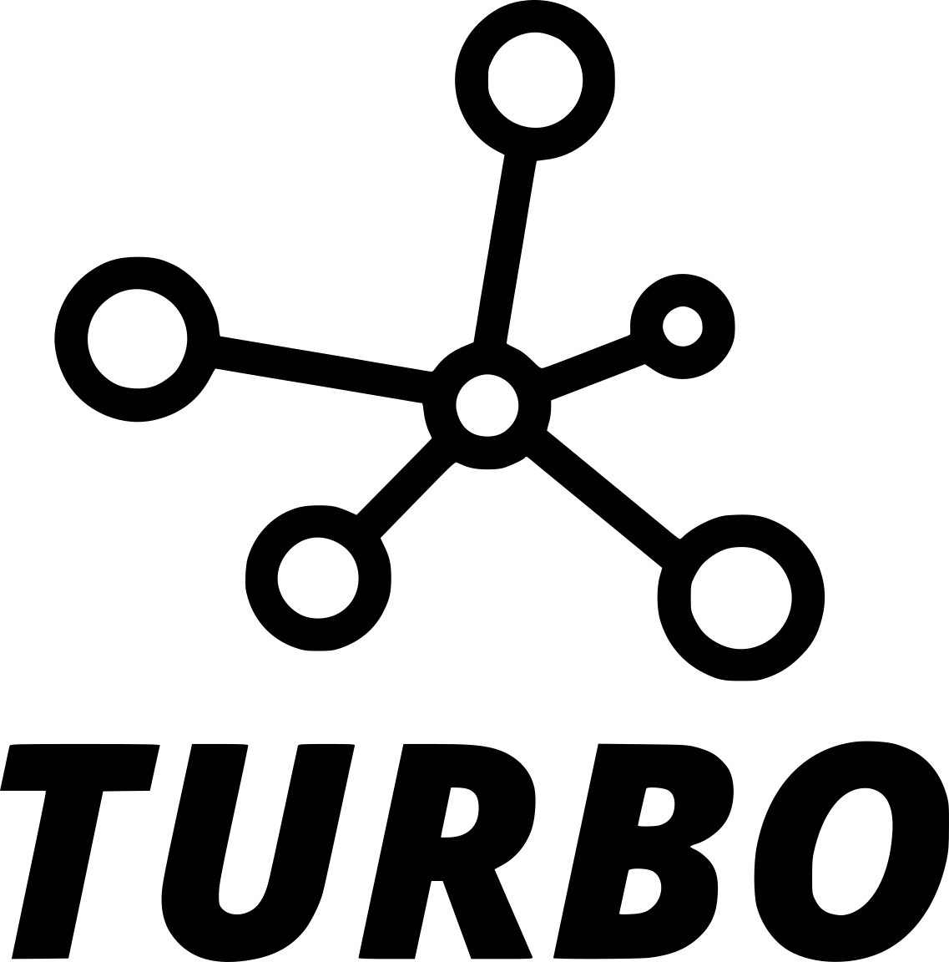
Semantic harmony for databases, community standards, and graphs
Striving for semantic harmony in a large project with a small ontology team
The VEuPathDB story (annotations, IRIs)
Aspiring to common terms and patterns across diverse domains and with diverse ontology backgrounds.
OBI/OBO Foundry (classes, TBox)
Applying ontology-driven tools on real-world data
TURBO and semantic graphs (individuals, ABox triples)
Notes:
I’m going to talk about these ontology aspects using three projects or efforts that I’ve worked on.
I’ll first show how we are striving to achieve semantic harmony across the large and complex VEuPathDB project using ontologies for annotations of data and datasets with unique identifiers (IRIs)
Next I’ll talk about how we work with others (many of you) to generate the classes and relations needed for those annotations (actual ontology work).
Finally, I’ll describe attempts to use these ontologies in a manner that makes use of the logic and structure in ontologies. I’ll show how real world data about individuals can benefit from realism-based ontologies.

Slide 7
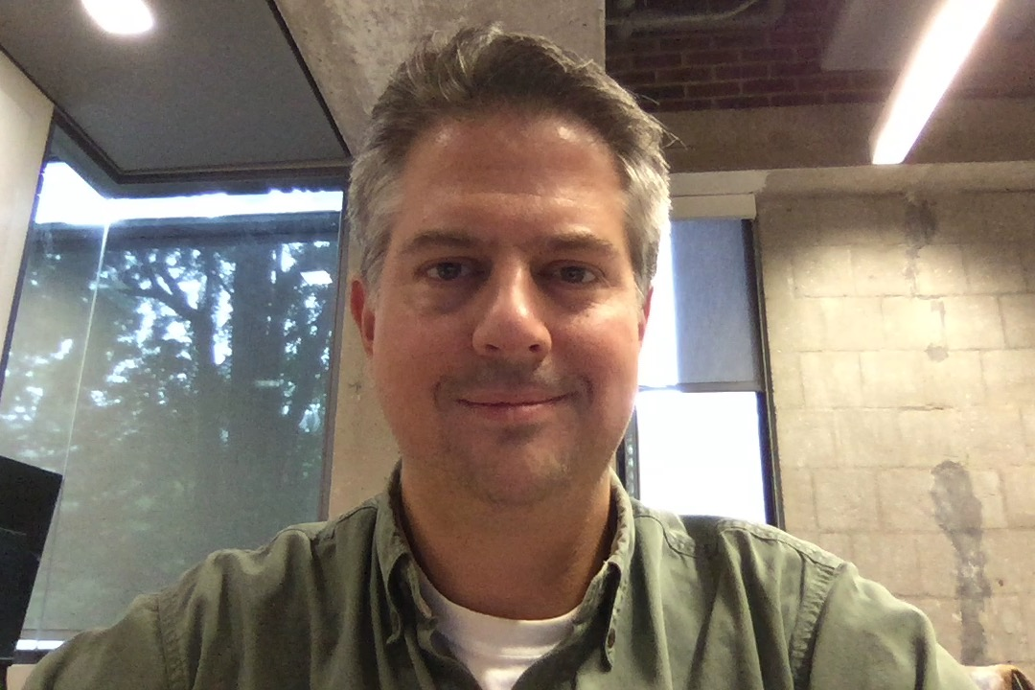
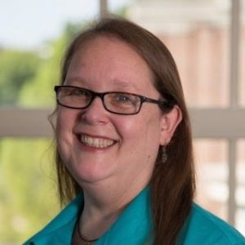
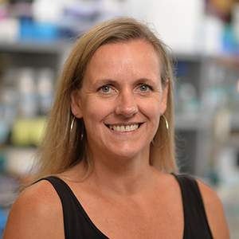
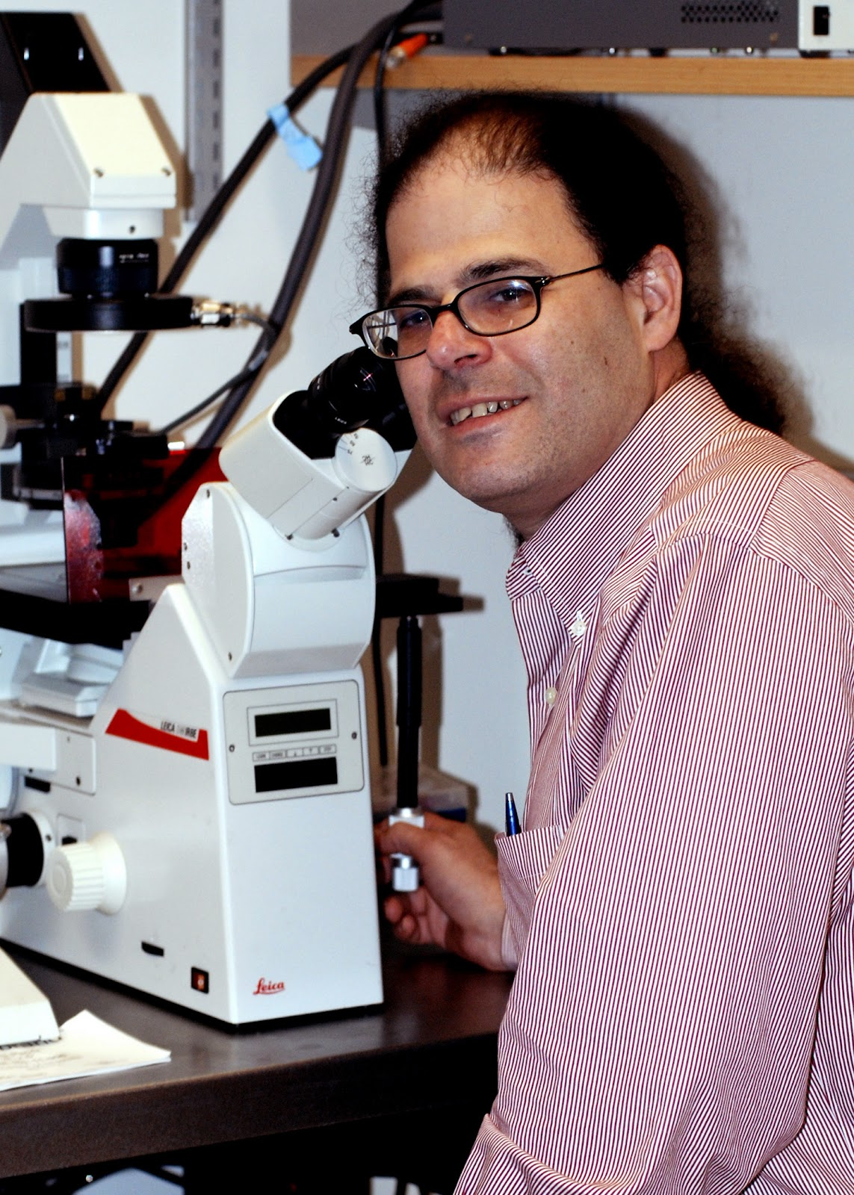
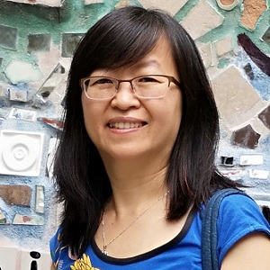
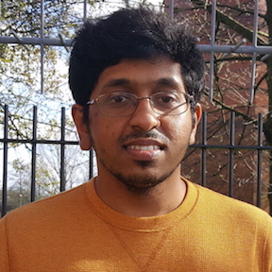
VEuPathDB is a collection of eukaryotic pathogen, vector, and host informatics resources
Primarily an NIAID-supported Bioinformatics Resource Center.
Also funding from Wellcome Trust. Now an Elixir-UK service selected to ensure high service quality and match UK priorities as identified by its funders.
Started in 2000 with the Plasmodium Genome Database - PlasmoDB (reflects a long running project) to provide researchers studying parasitic organisms a way to access genomic data.
Grew to include other ampicomplexans and then other pathogenic protozoa and then their vectors. Successful scalable infrastructure.
Amos B, Aurrecoechea C, Barba M, Barreto A, Basenko EY, Bażant W, Belnap R, Blevins AS, Böhme U, Brestelli J, Brunk BP, Caddick M, Callan D, Campbell L, Christensen MB, Christophides GK, Crouch K, Davis K, DeBarry J, Doherty R, Duan Y, Dunn M, Falke D, Fisher S, Flicek P, Fox B, Gajria B, Giraldo-Calderón GI, Harb OS, Harper E, Hertz-Fowler C, Hickman MJ, Howington C, Hu S, Humphrey J, Iodice J, Jones A, Judkins J, Kelly SA, Kissinger JC, Kwon DK, Lamoureux K, Lawson D, Li W, Lies K, Lodha D, Long J, MacCallum RM, Maslen G, McDowell MA, Nabrzyski J, Roos DS, Rund SSC, Schulman SW, Shanmugasundram A, Sitnik V, Spruill D, Starns D, Stoeckert CJ, Tomko SS, Wang H, Warrenfeltz S, Wieck R, Wilkinson PA, Xu L, Zheng J. VEuPathDB: the eukaryotic pathogen, vector and host bioinformatics resource center. Nucleic Acids Res. 2022 Jan 7;50(D1):D898-D911.
Cristian Cocos
Notes:
First let me tell you about VEuPathDB and what it provides.
NIAID BRC
Now an Elixir-UK service
Started as PlasmoDB in 2000
Grew to include other organisms
Recent paper describes current state and highlights the many people involved.
The project has been run with my colleagues David Roos and Jessie Kissinger for over 20 years with each of us taking various leads of the project. Previously we were known as EuPathDB but In the current incarnation we’ve merged with Vectorbase to become VEuPathDB and joined by Mary Ann McDowell as a Co-PI. All have been terrific in supporting and recognizing the importance of ontologies although it’s still remains a process for the entire team to understand what the ontology team is doing. The ontology team which I’ve led until this year is Jie Zheng and John Judkins with Jie taking over as lead now.
Achchuthan Shanmugasundram has been contributing with annotation and curation and Cristian Cocos is a former team member.

Slide 8
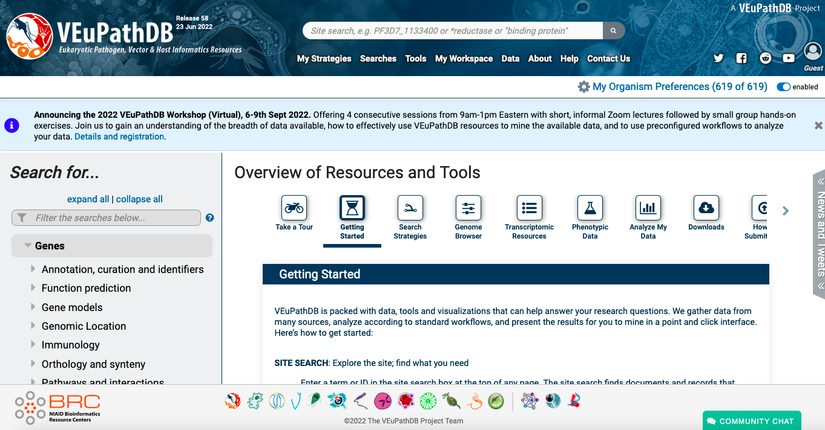
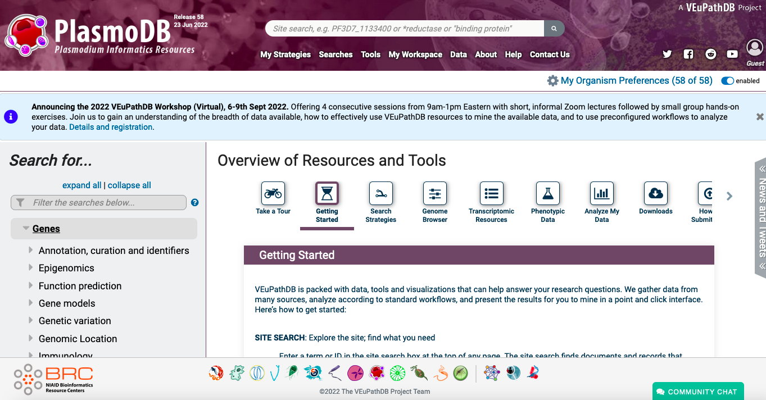
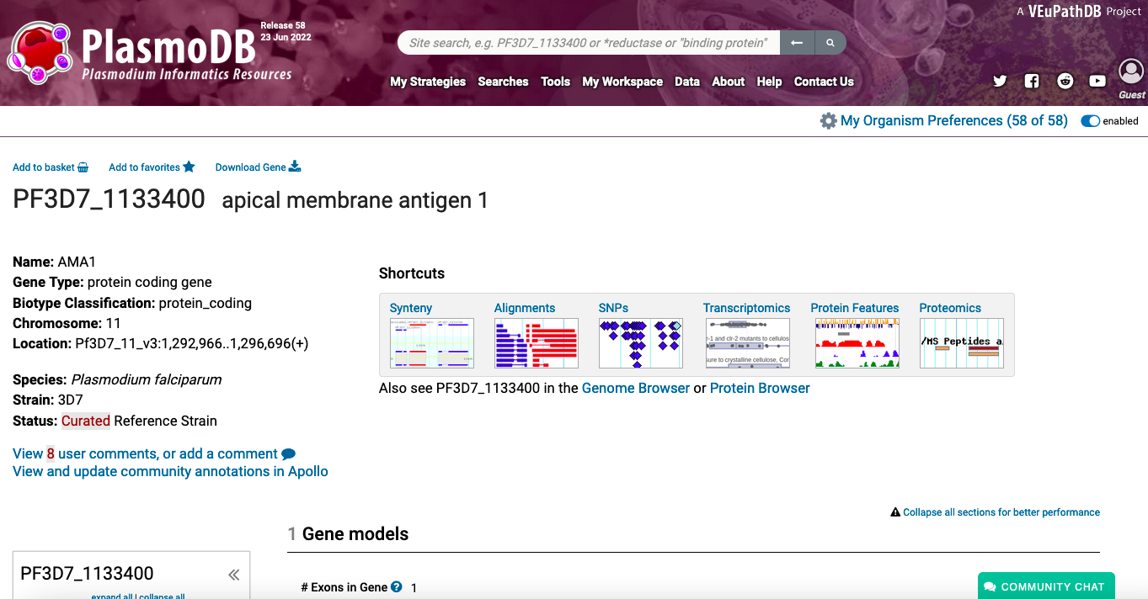
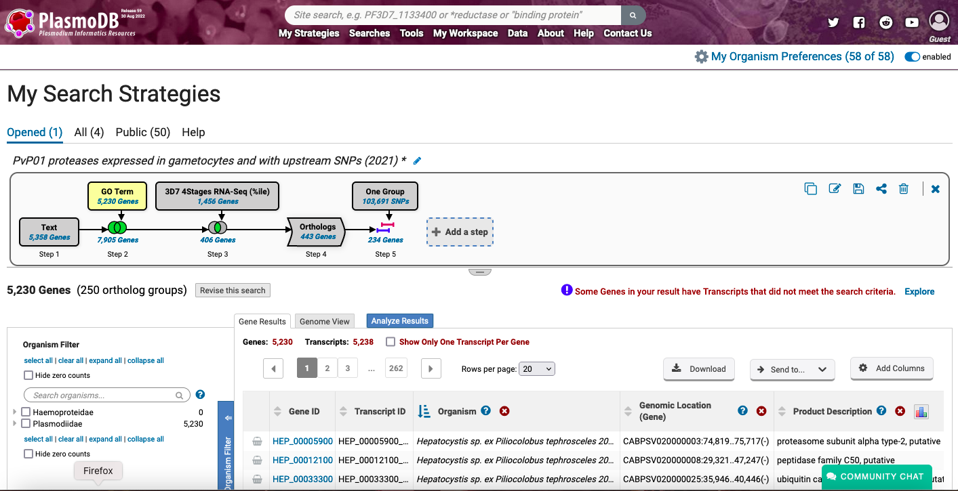
Notes:
VEuPathDB is collection of genomics sites – whose individual icons are shown at the bottom – which focus on organisms typically studied together such as PlasmoDB for the Plasmodium research community. The sties are very gene focused providing a wealth of different omics datasets that are chosen based on guidance from the different communities served – a key to our success has been significant investment in outreach activities. Another key feature of the site is to provide tools for investigators to explore the data and generate their own hypotheses such as searches based on a combination of annotations, expression data, orthology based on OrthoMCL that we developed, and genotype data.
The annotations for genomics datasets are primarily for gene / protein function using the Gene Ontology and a couple other ontologies pretty much like is done by the model organism databases. There are some additional experimental details but that has not been a major focus the genomics site.

Slide 9
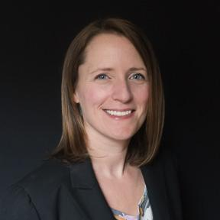
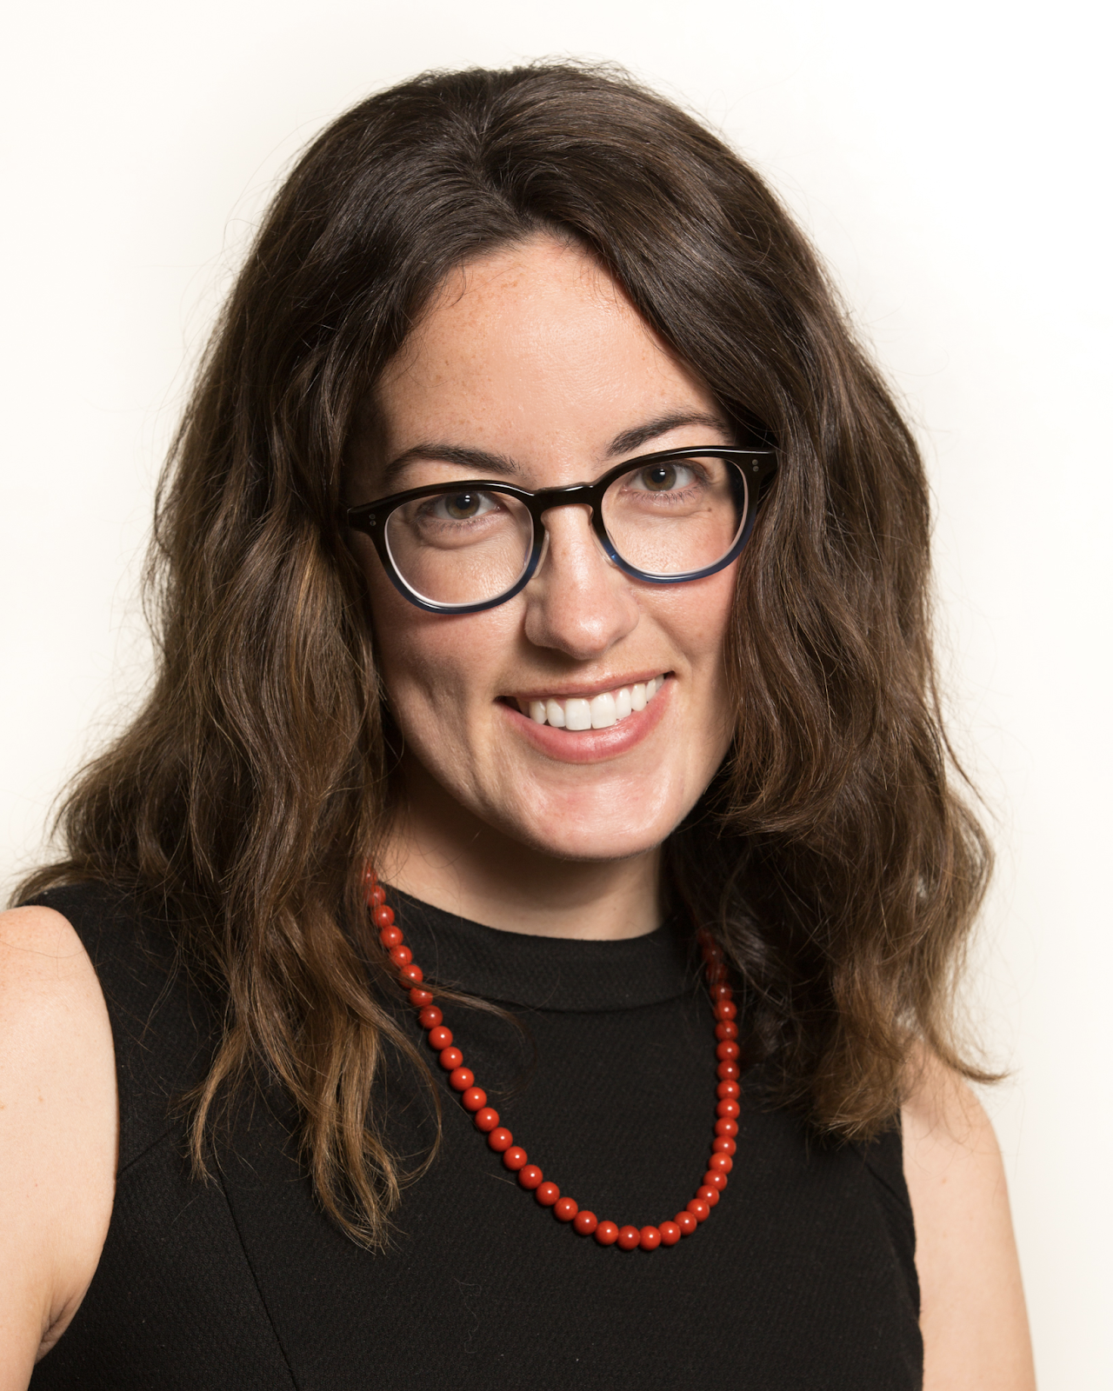
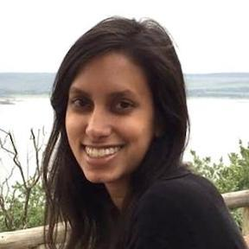
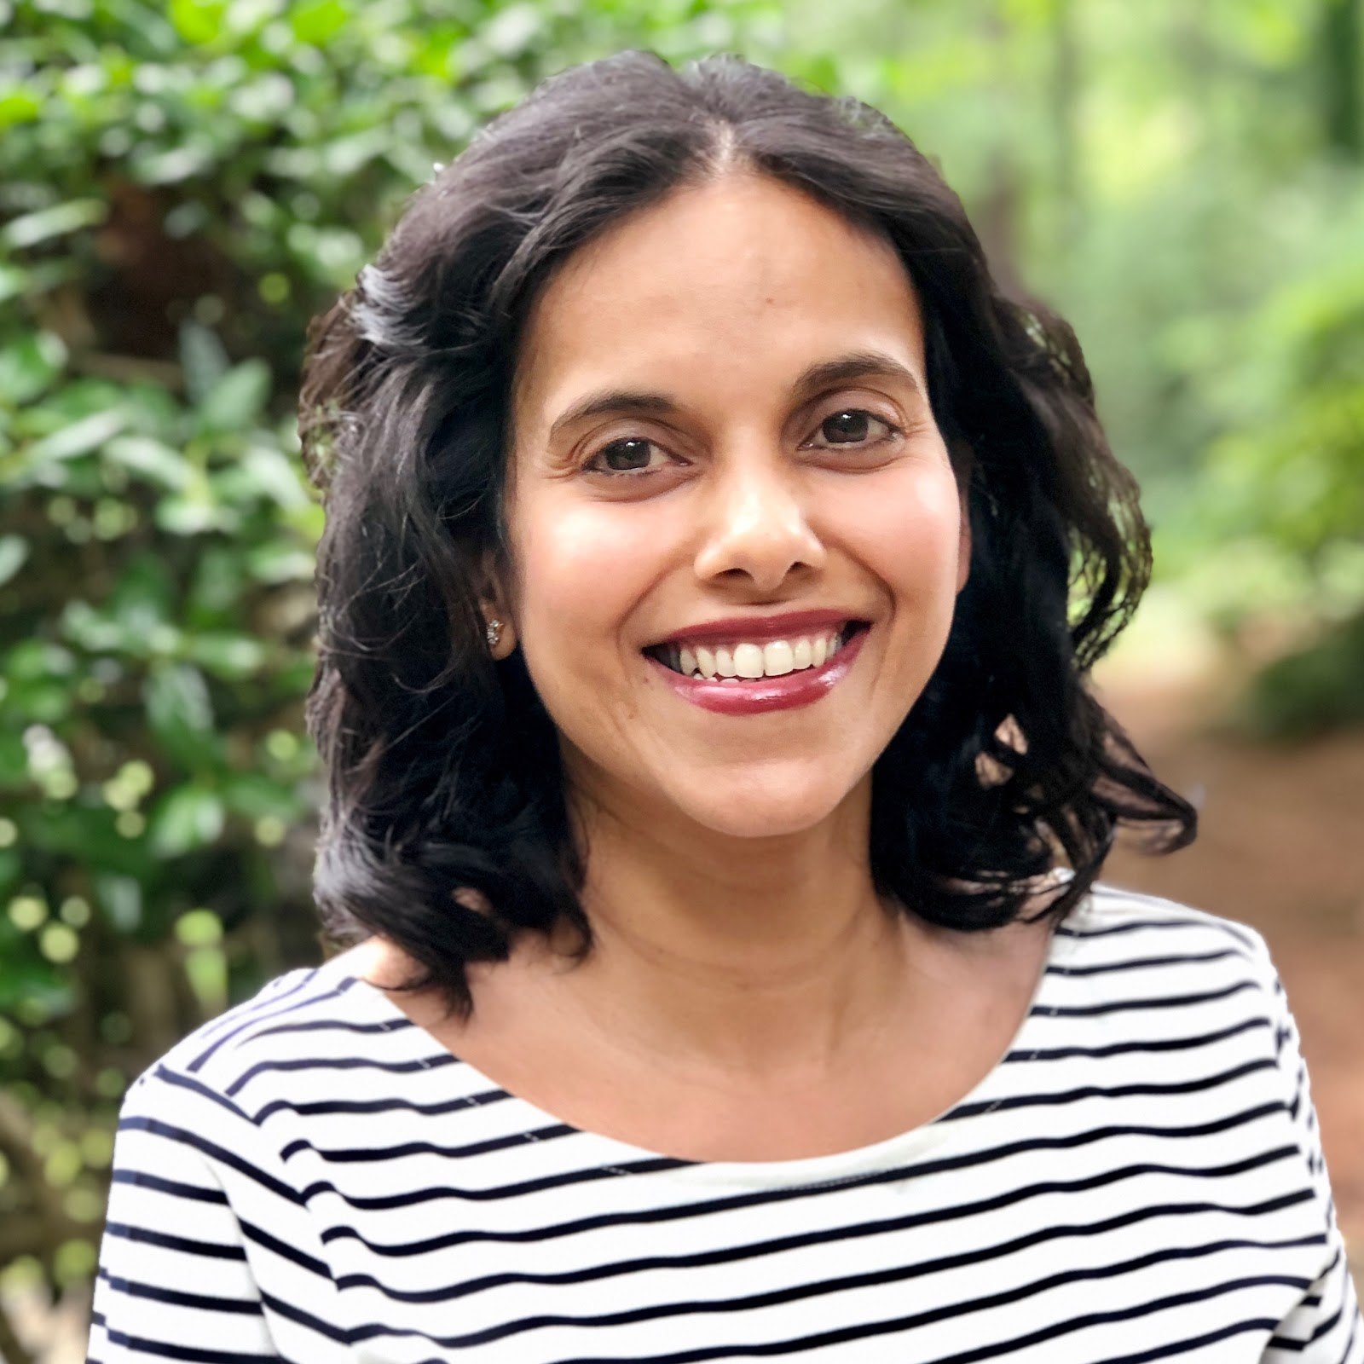
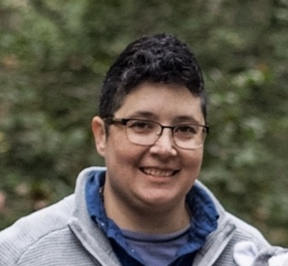
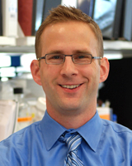
VEuPathDB has expanded to include ClinEpiDB and MicrobiomeDB
Now working with datasets from clinical epidemiology (ClinEpiDB) and microbiome (MicrobiomeDB) studies. (Functional) genomic datasets typically come with few “metadata” – sample and experimental details. Expanded system to cover complex demographic, clinical, and even social data impacting health.
While VEuPathDB sites are gene-centric, ClinEpiDB and MicrobiomeDB are organism-centric
ClinEpiDB: an open-access clinical epidemiology database resource encouraging online exploration of complex studies. Ruhamyankaka E, Brunk BP, Dorsey G, Harb OS, Helb DA, Judkins J, Kissinger JC, Lindsay B, Roos DS, San EJ, Stoeckert CJ, Zheng J, Tomko SS. Gates Open Res. 2020 Apr 6;3:1661. doi: 10.12688/gatesopenres.13087.2. eCollection 2019.
MicrobiomeDB: a systems biology platform for integrating, mining and analyzing microbiome experiments. Oliveira FS, Brestelli J, Cade S, Zheng J, Iodice J, Fischer S, Aurrecoechea C, Kissinger JC, Brunk BP, Stoeckert CJ Jr, Fernandes GR, Roos DS, Beiting DP. Nucleic Acids Res. 2018 Jan 4;46(D1):D684-D691.
Notes:
What has really pushed a need for ontology is the expansion of VEuPathDB to capture clinical epidemiology and microbiome data. For epidemiology data in ClinEpiDB especially, the data are largely from survey forms generating hundreds of data variables that need to be understood, managed and displayed. MicrobiomeDB has been focused on specimen collection details for exploring data so both of these really have driven an explosion of ontology terms. ClinEpiDB is largely driven by outreach and initially led by Brianna Lindsay. She’s left the project but a team of Danica, Sheena, Nupur Kittur, Steph Schulman, and others continue to work with data providers and the ontology team to understand and define data variables. MicrobiomeDB is led by Dan Beiting and he works with the ontology team on semantic harmonization.

Slide 10
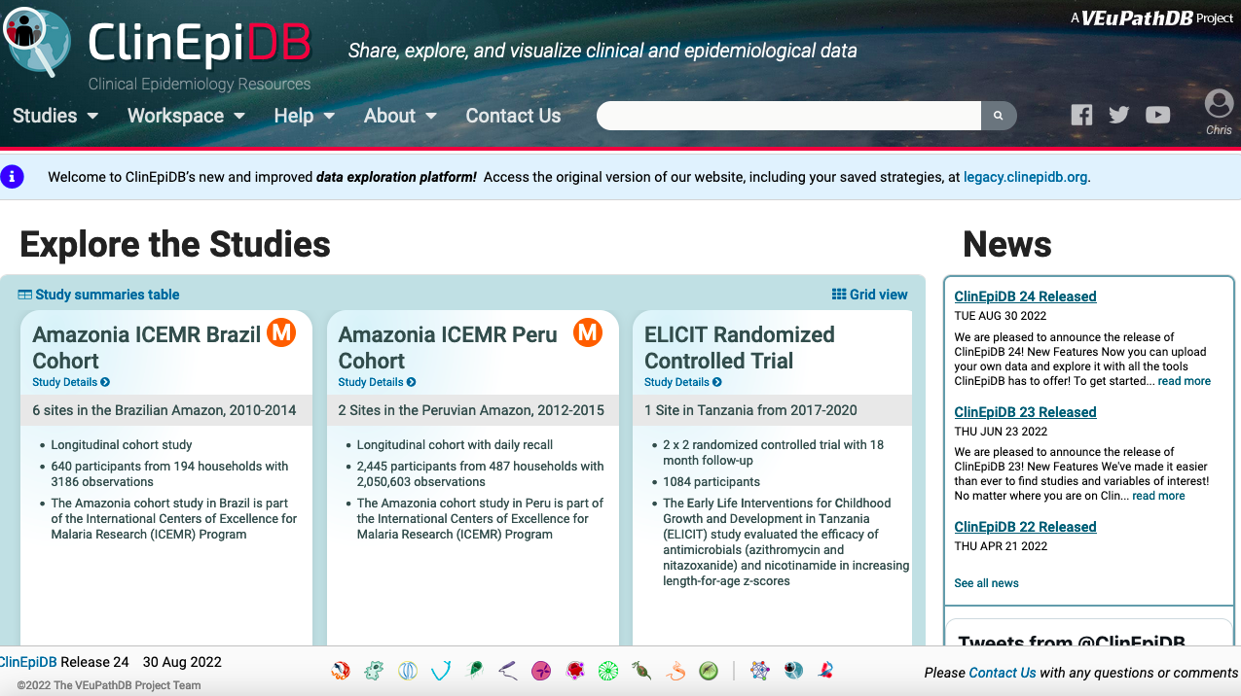
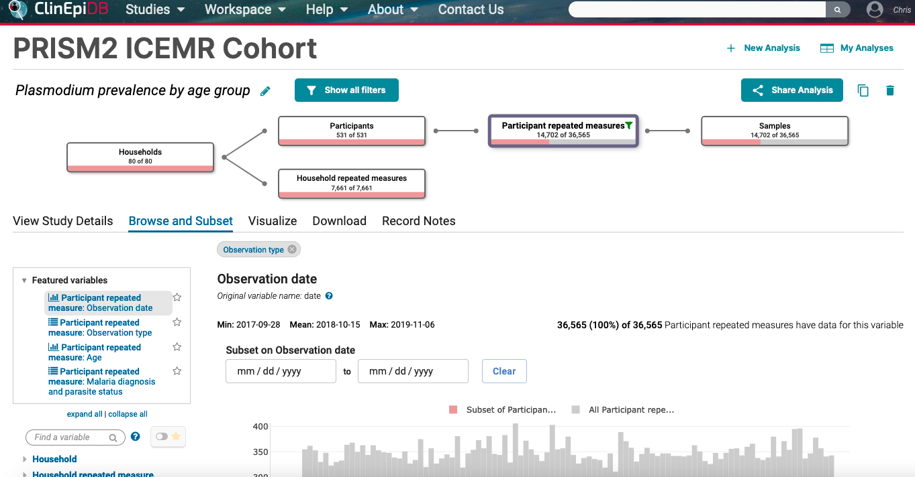
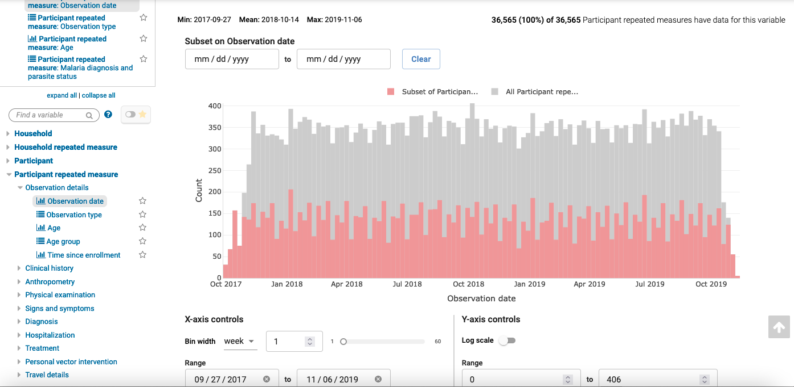
Notes:
While VEuPathDB sites have mostly been about genes, ClinEpiDB is about people, their living conditions, and their health. It contains datasets looking at the impact of diseases such as malaria or the effects of diarrhea or antimicrobial administration on child health and development.
The web interface is organized not by ontology terms but rather by how domain experts, in this case epidemiologists expect to see the terms. For example, in this dataset looking at Plasmodium prevalence by age group in Uganda, variables are grouped into categories such as households, participants, and samples.
* (point out) Variables are renamed and organized for exploring such as finding participants with repeated data measurements across the duration of the study and use these to subset the data.
PRISM = Program for Resistance, Immunology, Surveillance and Modeling of Malaria in Uganda 2 cohort study.

Slide 11
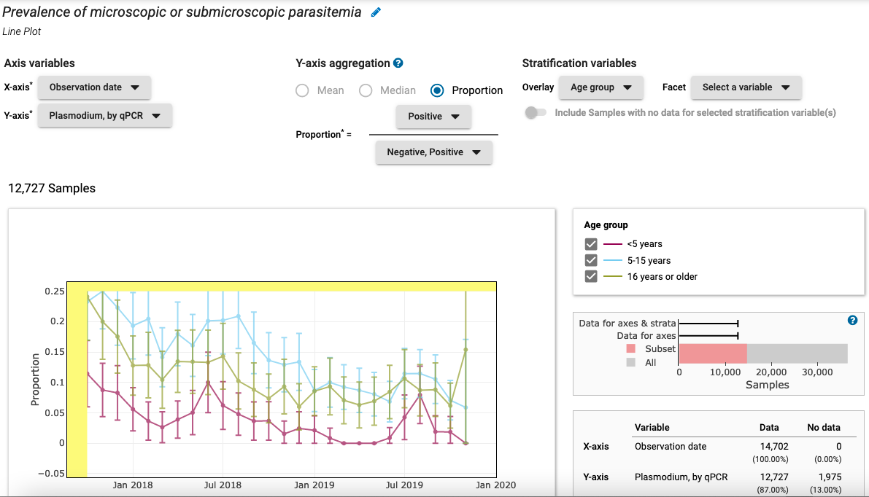
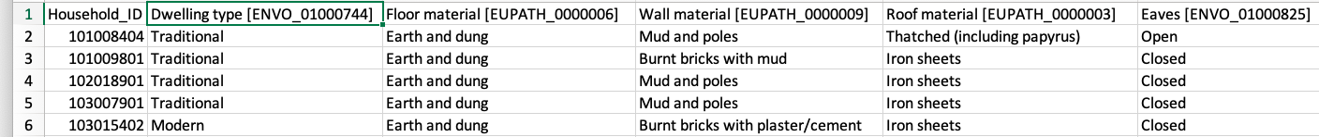
Human dwelling
Notes:
The chosen data can then be visualized such as looking at the prevalence of parasitemia in different age groups throughout the study period.
To manage consistency and achieve semantic harmony, every single variable is associated with an IRI for an ontology term. The IRIs are used internally for consistency checking. But the IRIs are also provided in download files for users. In this example, the terms are from the Environment Ontology, ENVO, and the VEuPathDB Ontology which I’ll describe in a minute.
* The table also highlights that we are using the IRI for the ENVO term not the label, human dwelling, which differs from the label used to display the associated data variable in order to fit the expectations of ClinEpiDB users.

Slide 12
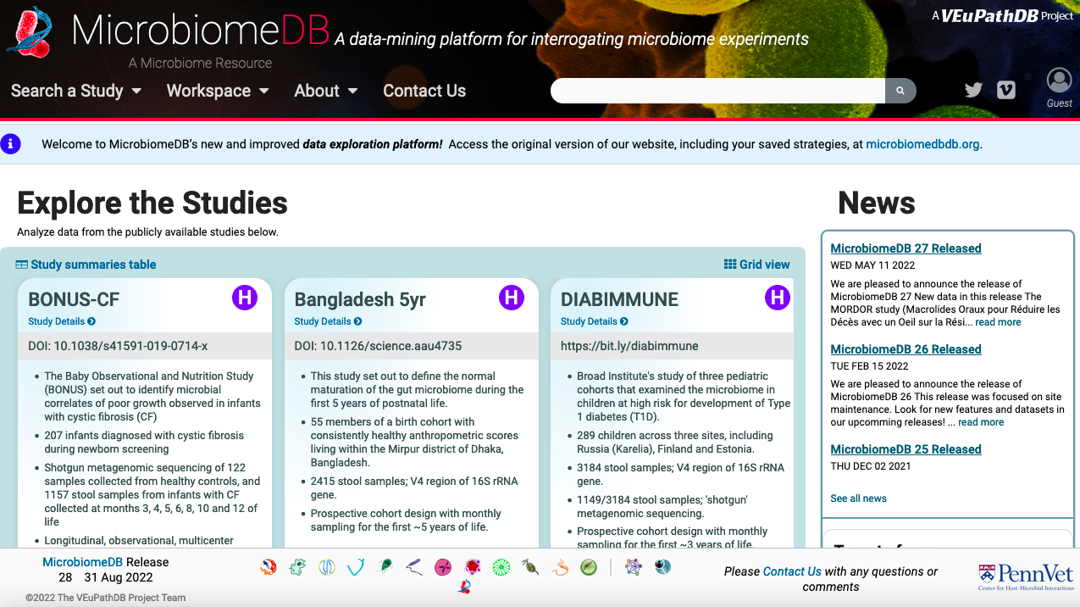
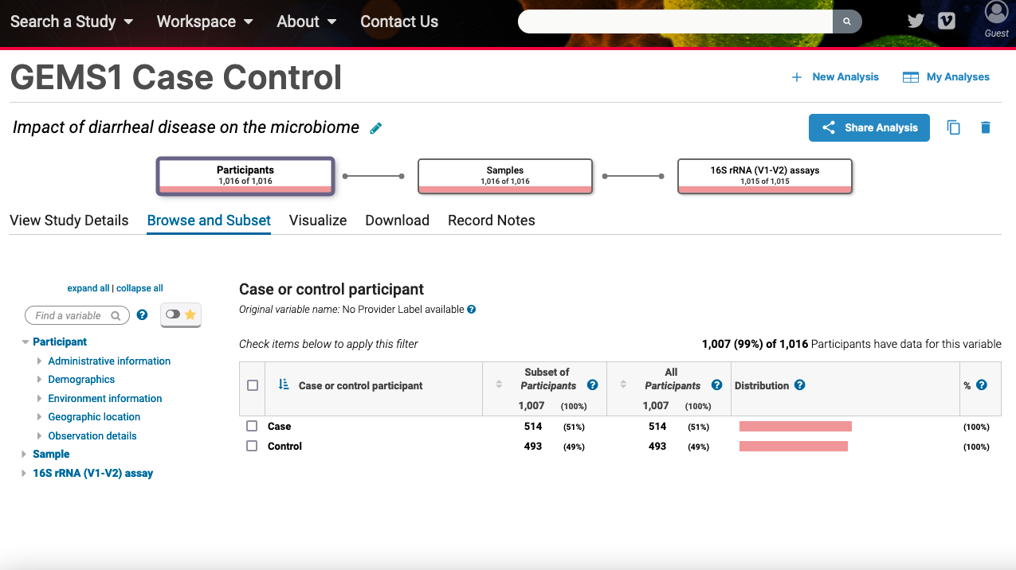
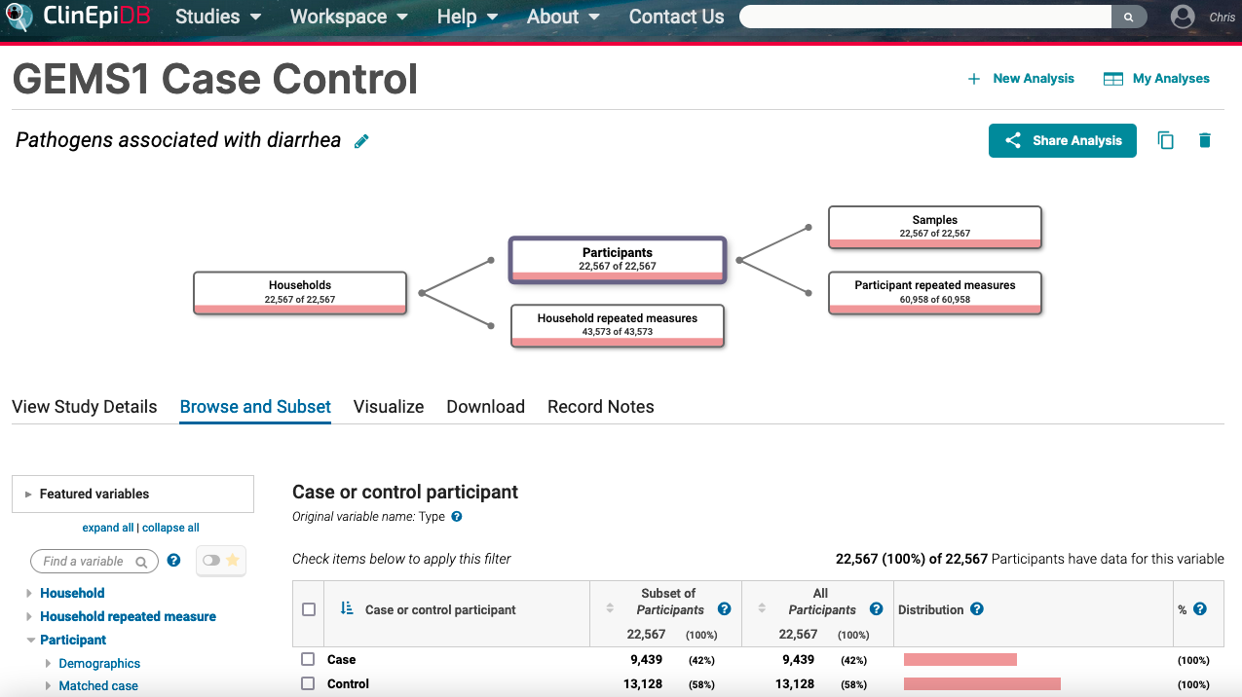
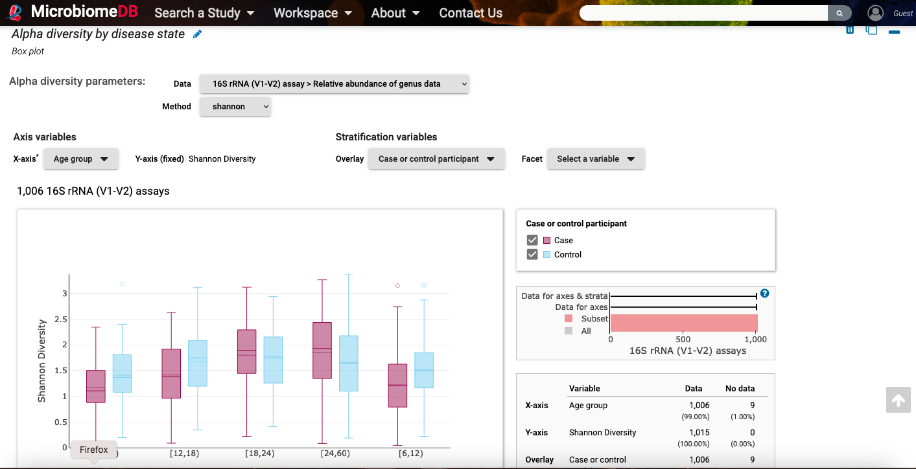
Notes:
MicrobiomeDB takes the same approach as ClinEpiDB and even contains some shared datasets but here the focus is on microbes and their prevalence in samples.
Like ClinEpiDB, variables are organized into participants and samples but also assays, Selected variables can be visualized dynamically such as comparing taxonomic diversity in age groups between children with severe diarrhea (cases) versus controls.
* This is one of the studies also in ClinEpiDB so we have the challenge of representing the data variables for different projects with different domains of users.
GEMS = Global Enteric Multi-center Study. Cases = severe diarrhea.

Slide 13
VEuPathDB Ontology supports the harmonization of annotations/data variables for genomic, epidemiological, and microbiome datasets
All annotations/data variables with the same label are equivalent and have the same IRI
Data variables are organized following the same web display hierarchy across sites (not the same as the ontology hierarchy).
Goal is to provide consistency (i.e., semantic harmony) – terms have the same meaning everywhere and can be found in the same way.
Notes:
We developed the VEuPathDB ontology to support all these projects by providing a selected set of terms from existing ontologies to use and to provide terms when they did not exist.
We are striving for semantic harmony though ensuring that:
All annotations ..
Annotations are organized ..
With the goal to ..

Slide 14
Semantic consistency of VEuPathDB dataset annotations is ontology-driven through “harmony” of IRIs during data loading
Data file
OWL file
Transformed into
Specifies
Provides IRIs (intended meaning)
ISA file
Ontology
Loaded into
GUS
Provides IRIs (foreign key constraints)
Extracted to
Entity value table
ISA file is ontology-driven.
Can validate whether annotations use registered ontology terms.
OWL file and ontology loaded into Genomics Unified Schema (GUS) ontology tables
Displayed on
Web site page
Notes:
Having these ontology terms enables us to validate and check annotations at the data loading stage. We have ontology tables in our relational database based on the Genomics Unified Schema that we developed and have been using for many years. We make use of the Investigation, Study, Assay or ISA standard to load data with annotations – it’s a tabular format with columns that can be used to specify the type of study annotation with ontology terms as I showed for the ClinEpiDB download example a couple slides ago.
Our data loading validators check if the IRI is in our ontology table. If it isn’t we know the ontology team needs to work on providing the correct one.

Slide 15
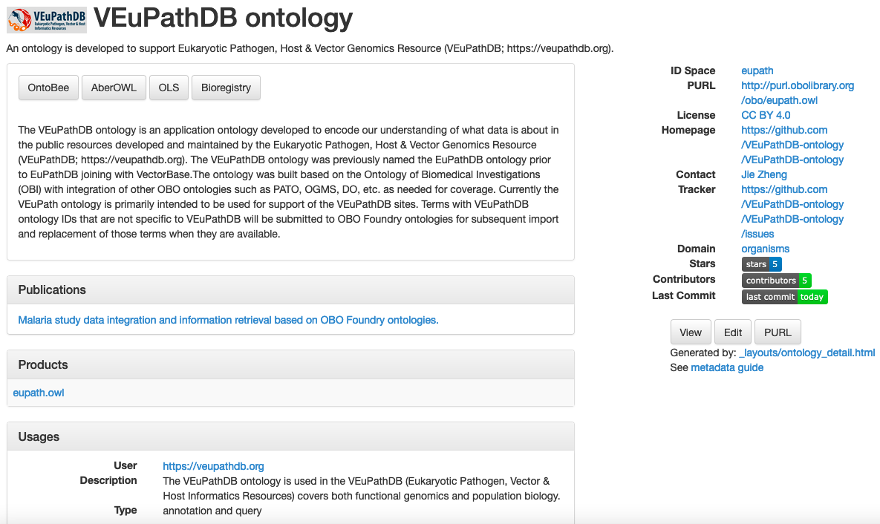
https://obofoundry.org/ontology/eupath.html
Notes:
The VEuPathDB ontology is public, part of the OBO Foundry, and available on multiple browsers.

Slide 16
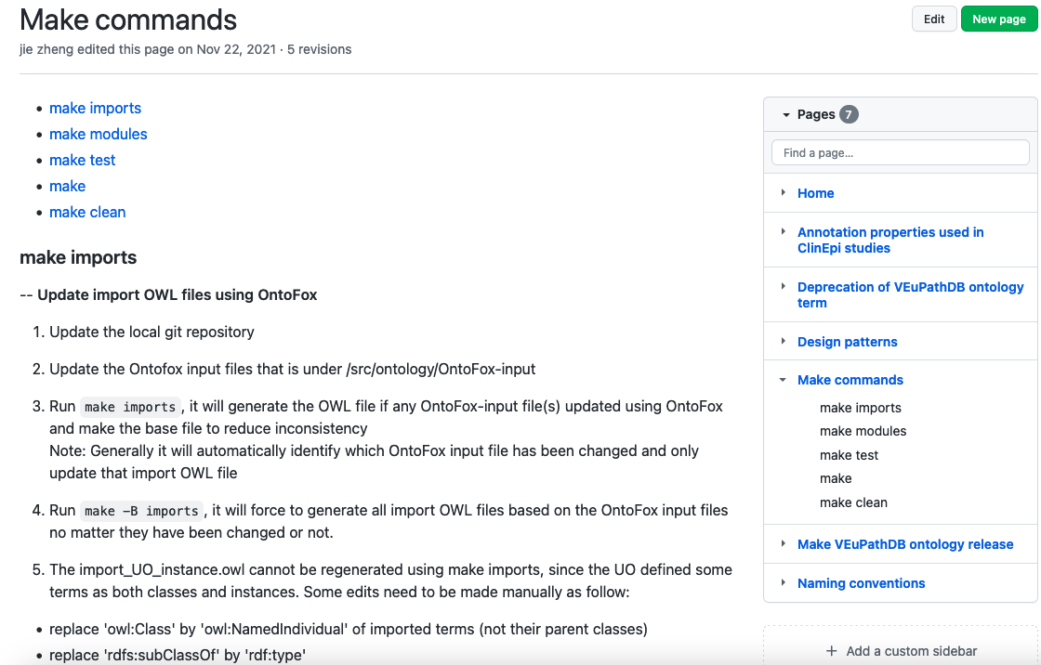
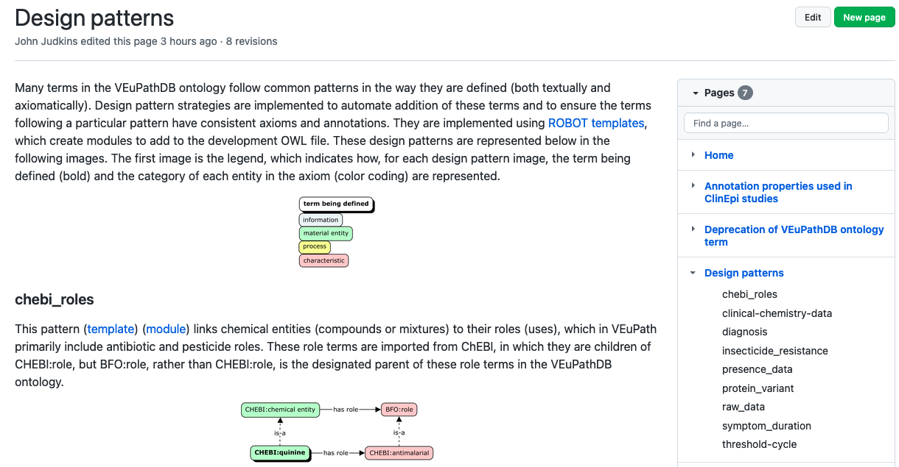
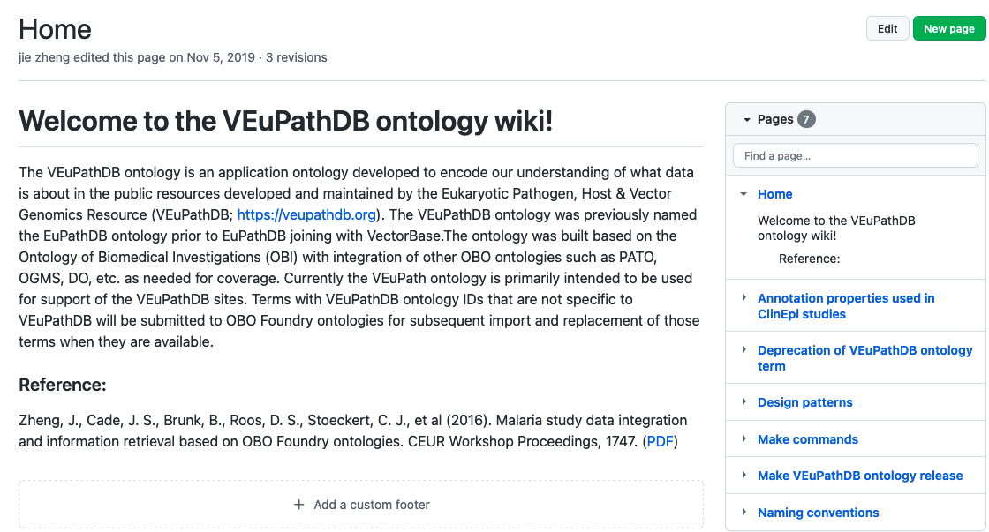
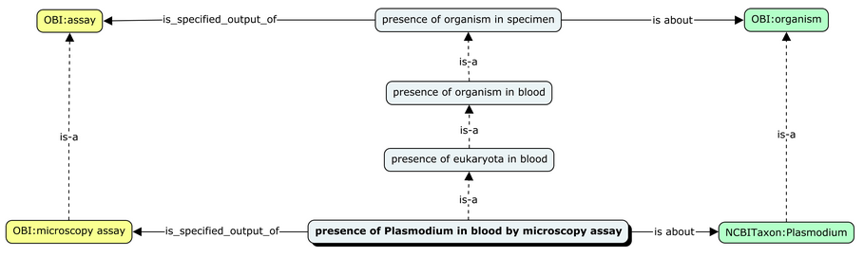
We “Make” the VEuPathDB Ontology with OntoFox, ROBOT, and templates
https://github.com/VEuPathDB-ontology
ROBOT: A command line tool to automate ontology workflows.
Notes:
At our GitHub site, we provide documentation on how we make our ontology. Our approach when appropriate is to use design patterns for defining new terms.
*These design pattern not only help us be consistent in how we create our own terms but also how we are using imported terms. The design patterns are implemented in tab-delimited files that are input into the ROBOT tool which output the ontology terms in OWL format.
ROBOT is a command line tool to automate ontology workflows, developed by James Overton and colleagues for the OBO Foundry.
This design pattern shows how we are capturing data items that are about organisms and are outputs of assays.
The OWL file from these design pattern based modules are merged into the VEuPathDB ontology using the build automation tool, make. Make is also used to merge in OWL files of imported terms generated with OntoFox (from Oliver He’s group). “Make test” calls on ROBOT to run checks on the ontology such as logical consistency and that definitions are there and formatted properly. Release files of the ontology are also generated with make.

Slide 17
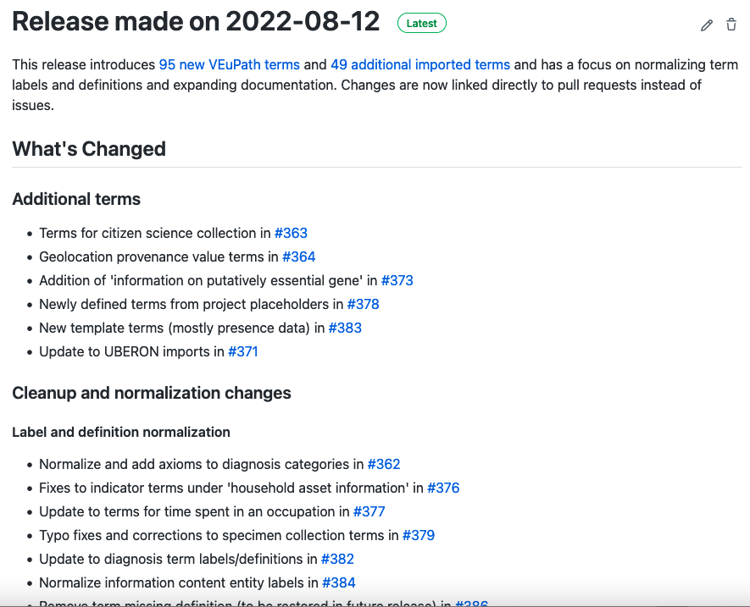
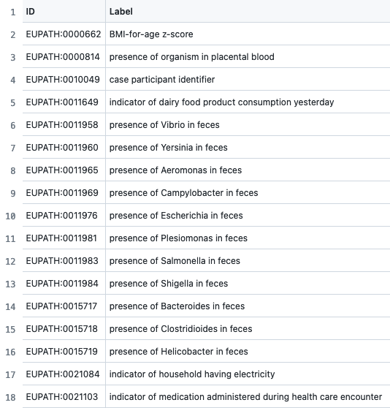
Notes:
We just made a release and through automating as much as possible are trying to do this on a monthly or bimonthly basis. Our release notes are meant to give you a sense as to what’s in the ontology with regard to imports and terms we’ve created as well as SOPs and documentation we are working on.
*These terms are examples of ones we’ve created in response to ClinEpiDB needs. They highlight the data items that are precomposed terms (data about and organism detected in a specimen)
* and we are trying to capture the composition in design patterns.

Slide 18
The VEuPathDB Ontology is an application ontology supporting VEuPathDB resources
Not trying to capture parasite biology. Employs other ontologies like the the Ontology of Parasite Lifecycles (OPL) to do that.
Primarily reuses terms from OBO Foundry. Imports terms from over 50 sources.
However, ~1900 terms out of ~5000 have EUPATH prefix (created by VEuPathDB) so there are a lot of terms only in the VEuPathDB ontology!
Many of these are placeholders. Active effort to get these in domain / reference ontologies.
Many are precomposed terms reflecting researcher-based distinctions.
E.g. ’presence of Plasmodium in blood by microscopy assay’, ‘specimen used for DNA PCR’
Universal or arbitrary grouping?
Notes:
The VEuPathDB ontology is an application ontology which has been somewhat controversial as to what these are and how they best fit in the OBO Foundry.
Not trying to capture parasite biology
Primarily reuses terms
A lot of terms are however only found in the VEuPathDB ontology
Many are placeholders needed for datasets but not available in the relevant reference ontology.
Also many terms are precomposed from ontology terms from different domains.
Such terms raise the question of whether they really are classes of universals found in the world or are they arbitrary groupings that should be in databases and not ontologies.

Slide 19
What is the value of having this VEuPathDB “application” ontology in the OBO Foundry?
DISCLAIMER: These are my views and don’t reflect the OBO Foundry!
Provides a basis for shared terms typically to be put in a domain/ reference ontology.
Get to share how we are ontologizing data from surveys and case report forms.
Show the design patterns we’ve come up with and naming conventions.
Is it ever OK to reuse our classes outside our projects? Why do we have them?
Need terms for database releases on different schedule from external ontology releases.
Contact us if you have need for the same term and we’ll work together to get it in the most relevant ontology. E.g., OBI, ENVO, OMRSE, PRO
Note this raises the issue of ontology class expressions (TBox) for ‘universals’ as opposed to arbitrary groupings.
Do classes for arbitrary groupings belong in reference ontologies?
Probably not, but do need a home because still be of general use and therefore has value for reuse.
Notes:
Since VEuPathDB is creating these Tbox expressions of arbitrary groupings, it raises the question: What is ..?
For my answer I should start with the Disclaimer that I’m sharing my thinking – not reflective of OBOF policy.
Provides a basis ..
OK to reuse these ..
Universals vs arbitrary groupings ..

Slide 20
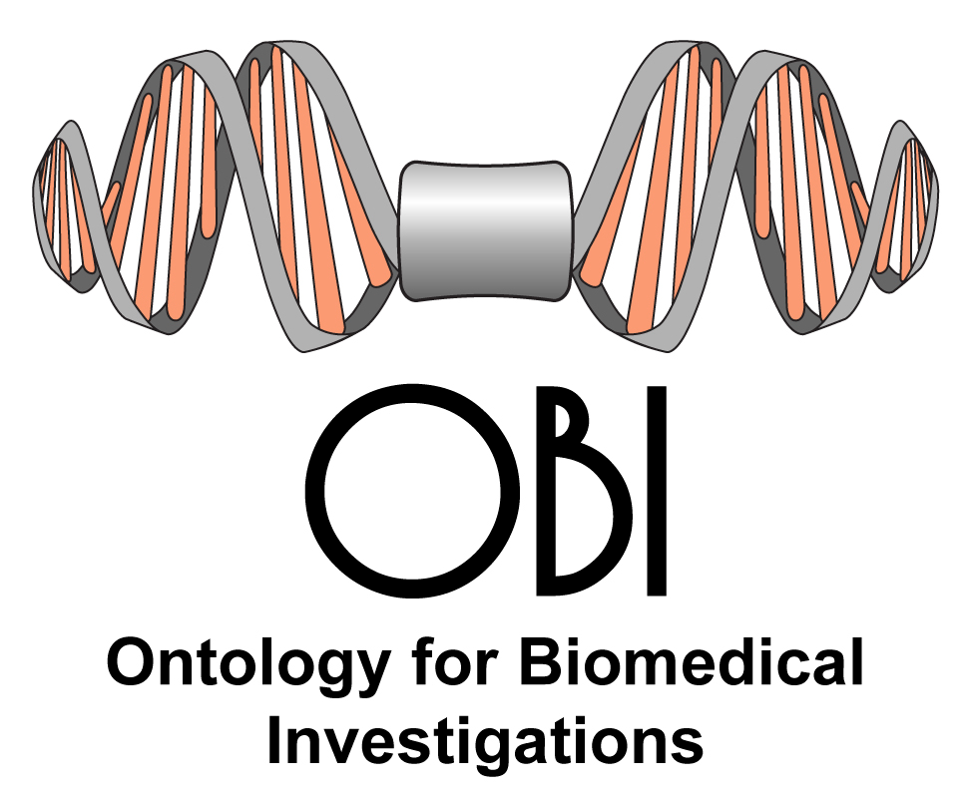
Aspiring to common terms and patterns across diverse domains and diverse ontology backgrounds with OBI
We could not have made the progress we have in VEuPathDB using ontologies without OBI and the OBO Foundry.
OBI is the Ontology for Biomedical Investigations and arose initially from the MGED ontology to cover microarray assays and then FuGO, functional genomics ontology.
Recognition that different technologies generating large datasets had a common need to describe experimental conditions, protocols, and designs.
The same specimens could be used for transcriptomics, proteomics, and metabolomics experiments.
Notes:
I’ve just raised some questions that have arisen from our semantic harmony efforts for datasets. Now I’d like to address how those questions can be addressed through community standards or at least community semantic harmony. I’ve called atterntion to OBI and the OBO Foundry and will now take time to describe them and how current activities are attempting to achieve semantic harmony starting with OBI and then the OBO Foundry.
First I should emphasize that we could not ..
The importance of these ontologies is not just the terms they provide but in providing standards for communities to use. OBI was born out of a requirement to provide minimal information about how experiments were done. Initially was the MIAME standard that many journals required for microarray-based datasets but quickly grew to other technologies that required proper annotations for data to be reusable. And understanding what those annotations mean is key to reuse.

Slide 21
Think OBI first when developing ontology terms related to peforming research!
Community benefits of working with OBI (extends to other OBOF)
Get broader input, more likely to be interoperable, and bigger impact
Weekly meetings where you can champion your terms
Not just an issue tracker but also GitHub pull requests (can track your terms!)
Vita R, Zheng J, Jackson R, Dooley D, Overton JA, Miller MA, Berrios DC, Scheuermann RH, He Y, McGinty HK, Brochhausen M, Lin AY, Jain SB, Chibucos MC, Judkins J, Giglio MG, Feng IY, Burns G, Brush MH, Peters B, Stoeckert CJ Jr. Standardization of assay representation in the Ontology for Biomedical Investigations. Database (Oxford). 2021 Jul 9;2021:baab040.
Design patterns and ROBOT templates
Working together to share and apply best practices
“Both the ontology terms and the OBI community were improved through this collaborative community effort, which made developers more aware of terms outside their area of expertise and gave them a better understanding of assay terms as a whole.”
Notes:
At the beginning of this talk, I showed examples of what OBI provides with specimen collection and assays.
What I want to emphasize now is the community aspect of OBI as an example of how we are trying to promote collaborative community effort.
Although OBI is driven by individual project needs (the rationale for working on OBI), it is truly not just about individual projects but providing general terms that are use case driven. We really want those of you developing ontologies to think OBI first when it comes to entities used in research.
Reasons for that include: Get broader input ..
We recently published a paper that gives you a sense for what OBI is about now. That paper describes the design pattern approach that OBI uses and which VEuPathDB is adopting as I showed you earlier.
The paper also describes how through workshops and our weekly calls we benefited from this community effort as captured by this quote:
Would like to highlight the leadership of Bjoern Peters on this work and OBI in general.

Slide 22
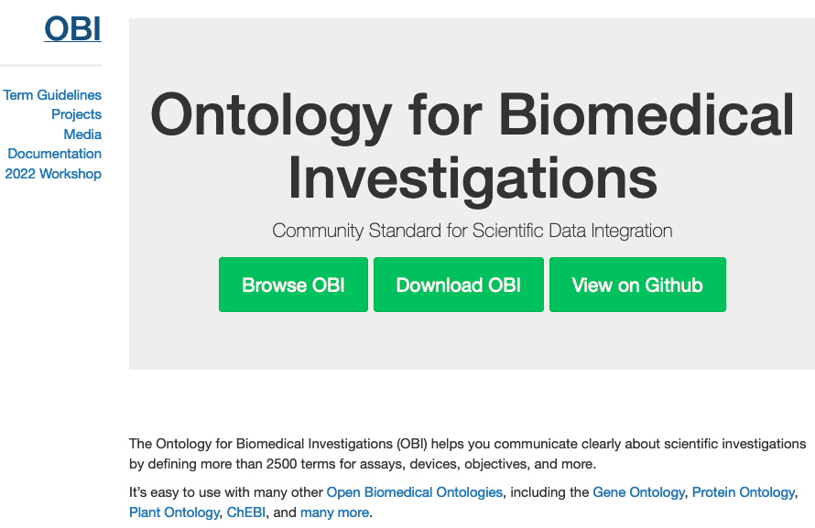
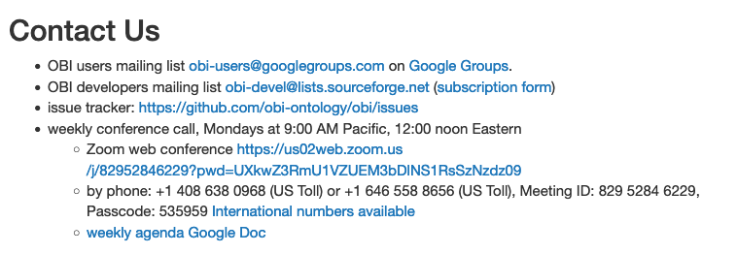
http://obi-ontology.org/
Notes:
At the OBI home page you’ll find ways to participate and learn about OBI practices. If you scroll down you’ll see links to our mailing list and issue tracker but also to our weekly meetings and notes.

Slide 23
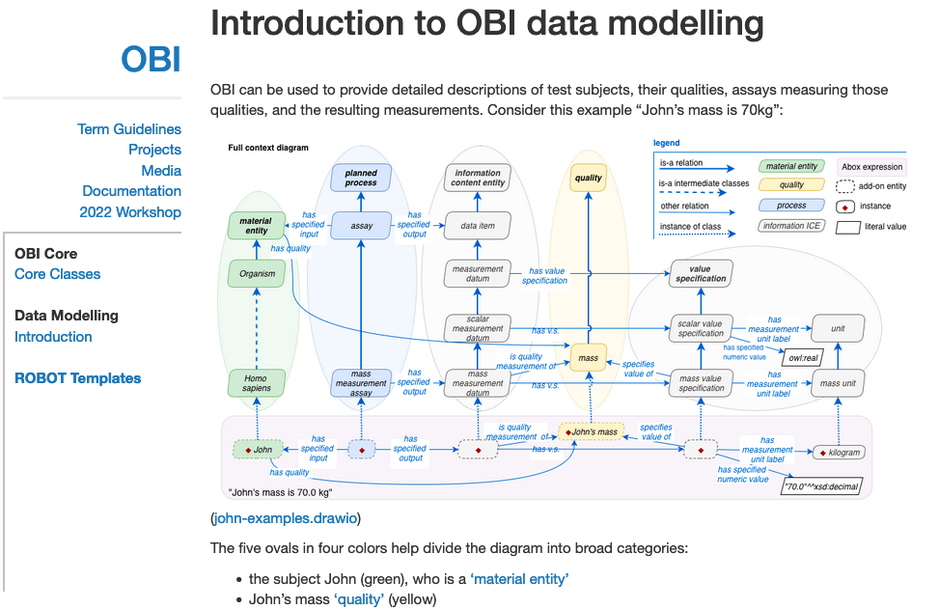
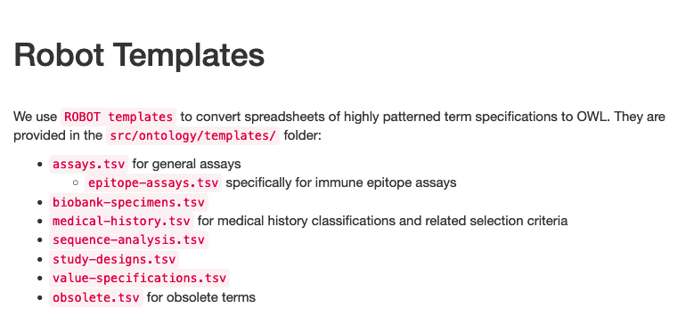
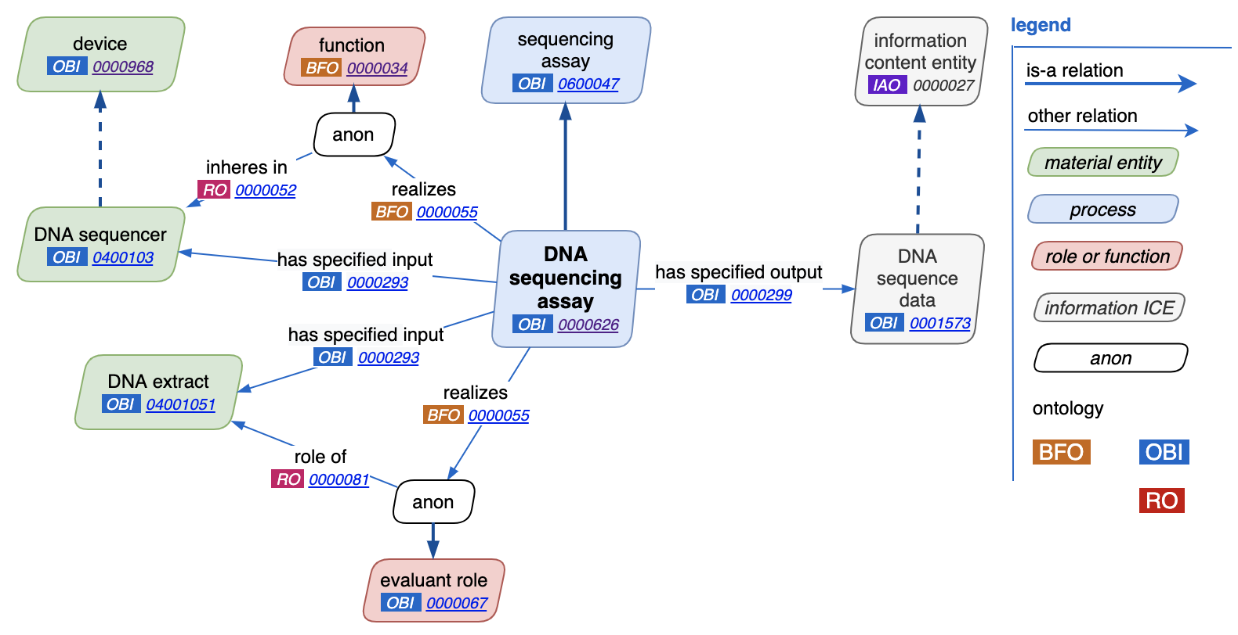
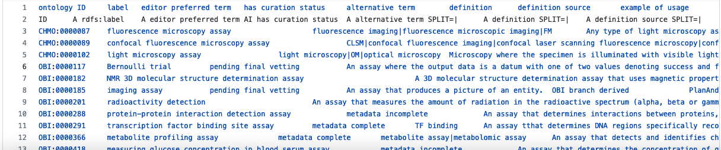
Notes:
We’ve been working on documentation. Includes our current modeling of representing data.
Earlier I mentioned how OBI and VEuPathDB use ROBOT and templates and OBI is becoming more and more template driven.
Here is a snap shot of what’s in the assay template. The idea is that anyone wanting a new type of assay to be added to OBI can just add it to the template which makes it quick and enforces consistency. The ROBOT output to this template is OWL as reflected in this figure from the paper I just mentioned.

Slide 24
Aspiring to common terms and patterns across diverse domains and ontology backgrounds with the OBO Foundry
OBO Foundry (OBOF) arose to provide interoperability for ontologies covering different domains
Requires principles for building and documenting the ontologies
Benefits from a common upper level and relations
Mainly for reference ontologies but many project-based ontologies have become involved
Ontologies for complex data can cross many domains and require a meta-community like the OBOF to get coverage at least at a mid to upper level.
OBO Foundry arose out of a recognition that communities should work together on ontologies.
Notes:
What we are doing with OBI is something we are trying to do for the OBO Foundry for a wide range of communities with biological and biomedical ontology needs.
Requirements for standards led to everyone building their own terminologies by groups who frankly did not know what they were doing and without any coordination leading to overlap of coverage. The OBO Foundry was started to address these. Great strides have been made but there is still much to do for achieving semantic harmony across communities.

Slide 25
OBOF is about representing what happened in reality not how things are stored in a database (or "cognitive representations on the part of domain experts”).*
BFO (Basic Formal Ontology) provides an upper level ontology to distinguish between material entities, processes, and information.
Now an ISO standard (in First Order Logic - not just OWL, thank you Alan Ruttenberg!)
Not the only upper level ontology and not everyone is happy about exposing non-ontologists to ‘continuants’ and ‘occurrents’ so still part of the struggle for semantic harmony across communities.
But we all use the Relations Ontology (RO)!
A requirement for being part of the OBO Foundry.
Connections (object properties) between ontology terms are often between different domains and RO provides the primary ones.
RO used in TBox definitions but are for ABox assertions on Instances of classes
* Ceusters, Smith. A realism-based approach to the evolution of biomedical ontologies.
AMIA Annu Symp Proc. 2006;2006:121-5.
Notes:
Barry Smith was critical to starting the OBO Foundry by emphasizing proper ontology building. One of the key design approaches that Barry, Werner Ceusters, and others brought to the OBO Foundry as I understood it, is that for communities to have a common data model, that model should be based on what happened in reality not in databases or in our heads.
Many of us, myself included, were initially creating terminologies to support software and database-driven schemas that led to a lot of confusion about describing ‘metadata’ about data rather than what the data is about.
We needed an upper level ontology, a starting point for each of our projects to reference.
The Basic Formal Ontology has been the answer for many of us. Now an ISO standard it can bring much clarity to how we think about structuring our ontology. But that formal structure has not been adopted by all the ontologies in that they are not all rooted in an BFO class.
Semantic harmony across communities also requires common patterns of defining terms with relations or object properties. Like everything else in the OBO Foundry, the Relations Ontology is a work in progress, but it is now well established and at least we have achieved a common agreed upon approach to connect terms (or rather instances of classes).

Slide 26
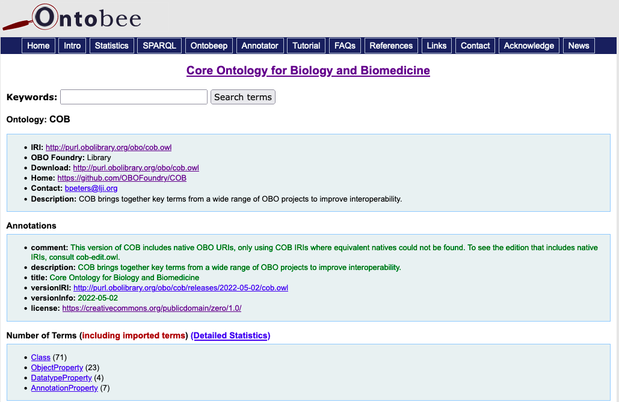
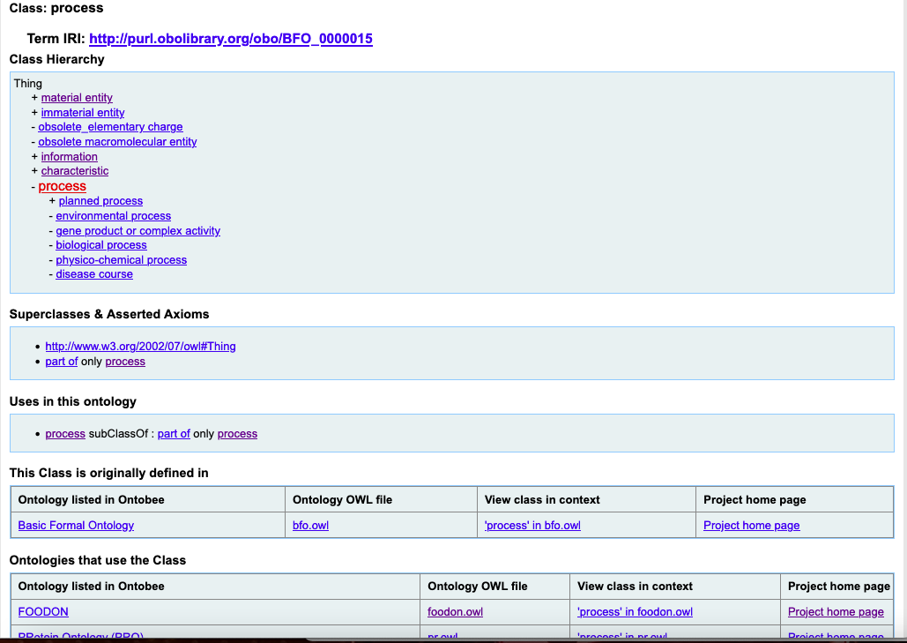
Aspiring to semantic harmony of terms across communities: Core Ontology for Biology and Biomedicine (COB)
From the COB GitHub page:
“This project is an attempt to bring together key terms from a wide range of Open Biological and Biomedical Ontology (OBO) projects into a single, small ontology. The goal is to improve interoperabilty and reuse across the OBO community through better coordination of key terms. Our plan is to keep this ontology small, but ensure that one or more COB terms can be used as the root of any given OBO library ontology.”
A work in progress: https://github.com/OBOFoundry/COB/issues
Notes:
I just mentioned that not all ontologies in the OBO Foundry use BFO for root terms which requires guessing and limits use of ontologies outside of their domain. To address this and other issues, the OBO Foundry is developing a core ontology which will be used to require all ontologies to use these few terms as roots. These are anchored BFO and high level terms from existing reference ontologies and will be used to help broker which IRIs to use and how they relate to equivalent terms and their IRIs. Note that this is a work in progress but open to input through discussion on the issue tracker and as Chris M described this morning you can make PRs and this is a community effort.

Slide 27
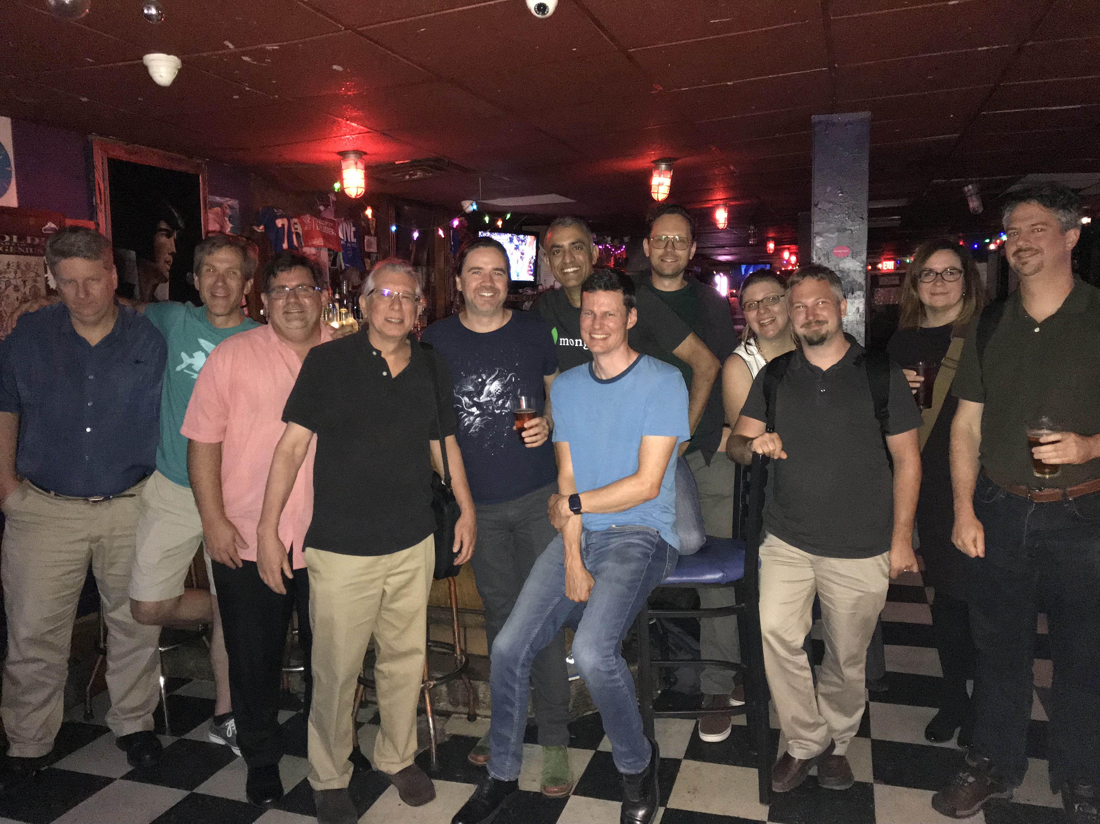

Harmonizing communities: OBO Foundry
Longstanding mechanisms for participation.
OBOF web site
OBO-discuss mail list
Meetings like ICBO
Notes:
We have long-standing mechanisms for participating in the OBO FOundry and I’ll highlight some updates. But I want to start by emphasizing that meetings like ICBO are critical for community building and integration. The pandemic has really impacted getting together in person and I hope we’ll see more in person participation because nothing like a nice dinner or hanging out in a dive bar in Buffalo to build community!

Slide 28
Harmonizing communities: OBO Foundry
New ways to be part of the community.
Slack https://obo-communitygroup.slack.com
>50 channels! >240 members in the general channel!
Ontologies (e.g., COB), technologies (e.g., SPARQL), tools (e.g., ODK), resources (e.g., Jobs)
Governance
On-line resources
Tool tutorials
OBO Semantic Engineering Training https://oboacademy.github.io/obook/ (Open Biological and Biomedical Ontologies Organized Knowledge)
Please attend the OBO Foundry Town Hall on Wednesday afternoon, Sept. 28.
Operations Committee
Governance
Notes:
The web site is just a start. Other ways to participate include a Slack workspace which I personally enjoy a lot and see posts from people new to OBO Foundry which is very exciting. Also thanks to support from Ramona Walls and the Critical Path Institute there is a terrific OBOOK (Open Biological and Biomedical Ontologies Organized Knowledge)
I mentioned earlier that outreach was a key to the success of the VEuPathDB resources. I believe it is key for achieving semantic harmony as well and there has been a renewed effort from the OBOF on this that needs to continue and grow. In that spirit, on Wednesday there will be a town hall event to share where we are as a community and get your input.

Slide 29




Notes:
The OBO Foundry has recently updated its home page to make finding ontologies more sensible.
This was done with volunteer effort as is much of how things are done as Nico Matentzoglu and Damion Dooley highlight in this post to obo discuss maling list.
There is an operation committee that is essentially made up of such volunteers. So part of achieving semantic harmony across communities is to have your community be one of those volunteers and I think that might be one of the town hall topics.
* The site has a wealth of information available through various drop down menus and pages such as links to tutorials such as the OBOOK I mentioned earlier.
* I also mentioned earlier that VEuPathDB has been successful in part by not trying to be just a repository but also by providing tools. Having ontology tools is critical for growing the ontology community. Oliver’s ontoanimal tools have been critical for our work. ROBOT from James Overton and colleagues is an extremely valuable tool that is growing in recognition and serving to power new tools like the Ontology Development Kit.
A new important analysis tool is the DashBoard that also uses ROBOT that provides automated checks of ontologies and is being used to assess how well they meet requirements largely defined in the OBO Foundry principles.

Slide 30


OBO Foundry recent activities have included working on operationalizing principles
Jackson R, Matentzoglu N, Overton JA, Vita R, Balhoff JP, Buttigieg PL, Carbon S, Courtot M, Diehl AD, Dooley DM, Duncan WD, Harris NL, Haendel MA, Lewis SE, Natale DA, Osumi-Sutherland D, Ruttenberg A, Schriml LM, Smith B, Stoeckert CJ Jr, Vasilevsky NA, Walls RL, Zheng J, Mungall CJ, Peters B. OBO Foundry in 2021: operationalizing open data principles to evaluate ontologies. Database (Oxford). 2021 Oct 26;2021:baab069. PMID: 34697637
Capturing consistent ontology metadata in the OBO registry
Defining operating principles for OBO ontologies
Establishing a framework for automatic evaluation of ontology metadata
Aids in being FAIR (Findable, Accessible, Interoperable, Reusable)
Not there yet but tools, tutorials, and communication platforms in place.
Notes:
The DashBoard and other efforts to operationalize OBO Foundry efforts are described in this paper from last year, The OBO Foundry principles shown here include being open, what formats are required, the use of IRIs, and so forth. For almost all of these, we’ve been able to programmatically check adherence to the principles, at least to some degree providing a way for to see how current and candidate ontologies are doing. The dashboard provides a quick view with associated reports and a separate dashboard has been set up new ontology requests to join the OBO Foundry.

Slide 31
Challenge of interoperating with other communities
Criteria for joining the OBO Foundry.
Scope: Use case relevant to life sciences.
Balance of inclusion and quality.
SOP for reviewers on new ontology requests is now available at https://obofoundry.org/docs/SOP.html (open for improvement).
Ontology / Semantic web communities:
Interoperability of OBOF principles and tools with other standards.
What are they? What are current connections? ENVO yes but Financial Industry Business Ontology (FIBO)? SNOMED? FHIR?
Presence at ICBO / joint conferences (e.g., with US2TS this year) has been a step in the right direction but unclear what progress comes of that.
Notes:
The OBOF activities have been important steps forward but there still are major challenges.
We encourage communities to join us but we have to be clear on who are in scope and what are expectations for the quality of the ontology. (SOPs)
But there’s a lot more to the Semantic web than OBOF.
Want to have semantic harmony with those already established and not going to join.
Heard this morning about the FHIR COVID Knowledge Accelerator WG that has interacted with STATO an OBO Foundry ontology covering statistics so that is encouraging.
I don’t have the solution other than for us to be aware of these challenges and keep the communication going.

Slide 32
Applying ontology-driven tools on real-world data: The TURBO story
Real-World Data (RWD): "data relating to patient health status and/or the delivery of health care routinely collected from a variety of sources.”
https://www.fda.gov/science-research/science-and-research-special-topics/real-world-evidence
Also RWD is typically messy! (inconsistent in use of fields and incomplete)
Billing codes (ICD) and problem lists (SNOMED, LOINC) capture the category for describing the patient diagnoses and findings but don’t provide a representation of the patient and the clinical experience (or a biobank specimen and its history and status).
Biobank and clinical data needs harmonization and integration with other data and are focused on individuals so a good ABox fit.
Notes:
So far I’ve addressed how IRIs are used in VEuPathDB and provided by OBO Foundry ontologies through TBox expressions. I’ll now address Abox assertions, the other dimension to my perspective on ontologies.
The TURBO project is my attempt to apply OBOF ontologies to individuals and address an area not well covered namely data in EHR.
We tried to do this working with the Penn Health System so the intent was real world applications to real world data.
Real world data is defined by the FDA is ..
It’s also messy, incomplete, and inconsistent and there’s a lot of it. Our clinical database has > 6 million patients with many records per patients.
While health practitioners can navigate and understand a patient’s record, this RWD is a barrier to performing research.
Another distinction of this data is that it is focused on individuals and so a good Abox fit.

Slide 33
Real-world data on individuals can best be represented as triples and captured as graphs
Including relations enables making explicit the implicit connections between data records.
Triples provide a mechanism to accomplish this:
<subject> <predicate> <object>
<patient1> obo:RO_0000056#participates_in <HCE1>
<HCE1> rdfs:type <obo:OGMS_0000097#’health care encounter’>
Modeling of real-world data is best done by ontological realism.*
Transforms data from different sources (and typically different schemas) to a common representation of what happened in the real world.
participates_in
patient1
HCE1
type
Health care encounter
Ceusters. The place of Referent Tracking in Biomedical Informatics
https://osf.io/q8hts/
Notes:
Because of this good Abox fit, I think real world world data on individuals can ..
That’s because including relations ..
By triples I mean subject predicate object. As a simple example ..
Triples allow fleshing out context especially important for prescriptions and diagnoses.
We think modeling of real world data is best done with ontological realism. That approach enables tracking of exactly what has happened in the real world and Werner Ceusters has written extensively on this referent tracking.

Slide 34
PennTURBO aims to facilitate clinical research through semantically rich representations of RWD
TURBO stands for Transforming and Unifying Research with Biomedical Ontologies.
Transform relational data to graphs gaining flexibility of queries
Unify data from different sources through alignment to reality (what data is about)
Research is supported by tracking provenance of data processing and integration
Biomedical Ontologies provide computable hierarchies and connections.
TURBO can find patients based on demographics (e.g., sex, BMI), diagnosis related to a disease class (e.g., lung cancer), medications prescribed (e.g., opioid orders), lab test results (e.g., blood glucose measurements), and representation in specific resources (e.g., Penn Medicine Biobank, the Penn Cancer Registry).
Notes:
TURBO is taking an Abox and realism approach to facilitate clinical research.
TURBO stands for ..

Slide 35



PennTURBO is comprised of three major components: Carnival, Knowledge graphs, and the Semantic Engine.
Carnival data integrator
Cohort Graph
TurboKG API
Query the Turbo Knowledgegraph
Cohort Graph
Carnival
Harmonize data into property graph,
Return graphs and reports
Semantic Engine
Transform simple instance data to OBO compliant RDF
Cohort Graph
Cohort Graphs
TURBO Ontology
Turbo KnowledgeGraph
Static RDF triple store that contains connected knowledge about diseases, meds, labs, and assays. Does not contain individual level patient data.
Data Sources
RDMS
Flat files
EPIC
OMOP
RedCap
Generator of patient cohort graph database (Semantic Engine)
Knowledgegraphs linking ontologies to searchable fields in EHR
Notes:
TURBO is comprised of three components of TURBO to access, integrate, and transform clinical data.
Carnival is our starting point and central to managing data. It’s used to pull data into a property graph, reconcile identifiers for the same entity, and represent in simplified semantics based on OBOF.
We currently use Neo4J but our code is not dependent on that.
We use OBOF ontologies to semantically link related data as triples in knowledgegraphs. For example we use ChEBI and DrOn to harmonize medications with RxNorm codes matched to free text for prescriptions. Mark Miller presented this work at an earlier ICBO. These knowledgebases are based on patient data but are not connected to individual patients rather they connect what’s found in EHR records for medications, diagnoses, and lab tests to ontology terms.
Carnival pulls, integrates, and transforms patient data into simple triples. We’ve built a semantic engine to expand those triples into explicit representations of a patients health care encounters with OBOF terms and relations.

Slide 36
The Semantic Engine uses a graph specification for allowable triples based on the TURBO Ontology
Application ontology that imports terms from > 20 OBOF ontologies.
Also includes TURBO project terms
“TURBO assertion making process” : A planned process that takes a datum as input and has a rdf:Statement as output. (used to track various recodings)
Originally built using Ontodog (started based on the Ontology for Biobanking - OBIB) and Ontofox (for imports).
Made a release this year with the Ontology Development Kit (ODK).
https://github.com/PennTURBO/turbo-ontology/releases/tag/2022-05-09
Notes:
The OBOF based semantics used by TURBO are captured in the TURBO ontology.

Slide 37

Notes:
Details of the semantic engine are available in this publication.

Slide 38
Explicitly expressing the semantics that are implicit in the data
Differs from ontology in defining
only a single way to relate instances
Notes:
Here’s a simple example of RWD typically in relational databases that is transformed to a triple that is then expanded to be OBOF-compliant
Standardize type to external resource. Capture provenance of ID.

Slide 39

Visualization of a TURBO graph pattern with mock EHR data: CYP2C19*2/*2 MI patient taking Clopidogrel
Clinical picture and therapeutic options: Patient had a recent myocardial infarction. Clopidogrel was prescribed to inhibit platelet aggregation via P2Y₁₂ antagonism. It was later determined that the patient has the CYP2C19*2/*2 genotype and lacks the enzyme necessary to convert Clopidogrel into its active form. However, the patient is wildtype for CYP2C9, the gene whose product does the analogous conversion for
Prasugrel, another P2Y₁₂ inhibitor.
Notes:
We’ve tested this system out on both synthetic and real world data. An example of the result here shows the integration of patient EHR records for diagnoses, medications, plus a genotype analysis that can be used to connect the medication to gene products that can utilize it.

Slide 40
Data fields currently included in the PennTURBO Group’s clinical data model
Category of Data | Fields Modeled
Patient demographics and observations | Centrally Registered Identifier (CRID) Date of Birth Gender Identity Racial Identity Height Weight BMI Systolic Blood Pressure Diastolic Blood Pressure
Healthcare and Biobank Encounters | Encounter Primary Key Date of Encounter
Diagnoses | Diagnosis Primary Key Diagnosis Code Diagnosis Code Registry (ICD9, ICD10, SNOMED, etc.) Diagnosis Description String
Medications | Medication Primary Key Medication Code Medication Code Registry (e.g., RxNorm) Medication Description String
Notes:
We are currently capturing a subset of basic data.

Slide 41
Can it scale? Comparison of the time taken for the Semantic Engine to transform various types of data, by cohort size.
Cohort Size (Patients) | Patient Instantiation Time (seconds) | Encounter Instantiation Time (seconds) | Diagnosis Instantiation Time (seconds) | Medication Expansion Time (seconds)
1,000 | 3 | 47 | 6 | 21
10,000 | 29 | 444 | 62 | 238
100,000 | 255 | 3,004 | 542 | 1,757
1,000,000 | 2,937 | 37,724 | 8,734 | 24,573
Notes:
When I presented TURBO at ICBO 3 years ago and was asked about scaling. Using synthetic data we have made this work with 1 million patients covering the fields just shown.
Time ranges from 1 minute for 1000 patients to 10 hours for a million patients.
Comparison of the time taken for the Semantic Expander to transform various types of data, by cohort size. The table shows an approximately linear relationship between size and time.
1 hour = 3600 seconds

Slide 42
Applying ontology-driven tools on real world data: Challenges to applying TURBO
Using knowledge graphs to connect RWD to ontologies requires significant mapping.
Need more developers comfortable with graphs, working with triples.
Operationalizing in a SQL world, matching ontology expressiveness to the needs of the data.
Recognition of benefit for data integration where individuals matter.
Notes:
Although our system has been tested on Penn Health System data we have fallen short of operationalizing it.
Technically it works but working with a Health System has highlighted other challenges.

Slide 43
We are developing PennTURBO as generalizable open source projects using GitHub
TURBO team: Heather Williams, Tom Hutchinson, Danielle Mowery, Hayden Freedman (UCI) , Mark Miller (LBL), Chris Stoeckert, David Birtwell (USC)
Carnival: https://github.com/carnival-data/carnival
Heather Williams, Tom Hutchinson, David Birtwell, Louis Lee
Semantic Engine: https://github.com/PennTURBO/semantic-engine
Hayden Freedman and the TURBO team
Knowledge Graphs
Tom Huthchinson, Mark Miller and the TURBO team
https://github.com/PennTURBO/medication-knowledgegraph-pipeline
text strings to RxNorm to drugs and their roles
https://github.com/PennTURBO/disease-diagnosis-knowledgegraph-pipeline
ICD codes to disease terms
Currently working on a lab test knowledge graph pipeline.
https://pennturbo.github.io/Turbo-Documentation/
Notes:
We haven’t given up on TURBO and still think it is useful at least for research projects. These are being pursued in research grants by Danielle Mowery and others at Penn.
For that and to share with others our focus now is on making these shareable and usable by others.
Tom Huthcinson has joined the TURBO team to help us with this effort.
All on public GitHubs and working on better documentation

Slide 44
Insights from a holistic approach in striving for semantic harmony of datasets, communities, and RWD
Striving to achieve semantic harmony across datasets in VEuPathDB has identified issues to be addressed as a community of ontology developers
Patterns for ontology terms
Role of application ontologies
OBI and OBOF are addressing issues of semantic harmony through encouraging community involvement
Providing tools (ROBOT, Dashboard), tutorials, and communication platforms but need more outreach.
Balancing inclusivity and quality
Real-world data is about individuals (ABox).
Carnival enables the aggregation of data from disparate sources into a unified property graph and provides mechanisms to model and interact with the graph in well-defined ways inspired by OBO Foundry ontologies.
TURBO Semantic Engine generates RDF triples with OBOF semantics denoting patients and their health care encounters.
Ontology
ABox
TBox
IRIs
Notes:
Started by saying being aware of different levels / dimensions can help. Most will just benefit from available IRIs or classes.
If working with individuals (people, specimens) many benefits of A-box. But even if just building ontologies, issue of why include axioms and how complicated.
With this holistic view of ontologies in mind I’ll close out by reviewing the three harmonizations I’ve presented starting with dataset harmonizations.
Next, I want to emphasize that harmonization is not just technical but also very much social.
Requires more than annotation (ability to search and apply ontologies).
Not emphasizing individuals from the start in our tools to highlight strength as opposed to trying to compete in spaces (cohort explorer, knowledge graphs) that other approaches can be just as good and have their strengths.

Slide 45
Acknowledgements
VEuPathDB: National Institute of Allergy and Infectious Diseases, Wellcome Trust (UK)
ClinEpiDB/ MicrobiomeDB: Bill & Melinda Gates Foundation
OBI/ OBO Foundry: Many communities who have contributed!
NIH grant 1R24HG010032: Services to support the OBO Foundry standards (Bjoern Peters, Chris Mungall)
Volunteers are essential but central funding really accelerates progress!
TURBO: Support from the Penn Institute for Biomedical Informatics, University of Pennsylvania Health System, and the Penn Institute for Translational Medicine and Therapeutics
Many many colleagues through out the years!
Thank you!
Notes:
End by acknowledging the funders of the projects I presented.
While much of the OBO Foundry work has been volunteer, we did greatly benefit from a grant to CM and BP and through their leadership that has been tremendously successful in accelerating progress. But we do need more of these.
Over my career have gotten to work with many terrific people who have contributed to the standards and projects and my own ontological path to strive for semantic harmony.

